Slide 1
Instructor Notes
Ensure you update your contact information on the Title slide
This class is a combination of Lecture, Demo and Lab
Class duration is expected to be approximately 4 hours
All Demos and Labs are described in the slide Notes
File Power BI Adv M Final.pbix will be used by the students in Labs.
Save a copy of this file to add DAX and perform demos during class. It is easier to save a copy as in one demo, you will need to show “before and after” file sizes
Answers to the Knowledge Checks can be found in the Appendix
PBIX file has a FullPath parameter which can be adjusted to the location of the source data file VanArsdel_Actuals.xlsx
Download and install Power BI Desktop:
Download and install Microsoft Power BI Desktop from: http://www.microsoft.com/en-us/download/details.aspx?id=45331
Open Power Query Formula Language link
© 2020 Microsoft. All rights reserved.
Notes:
INSTRUCTORS:
Please enter your name, photo, background, interesting facts, and contact information.

Slide 2
Enhance your Data Model Power BI Advanced
September 2020 release
Notes:
INSTRUCTORS:
Presentation notes are only provided when there’s relevant information beyond what is presented in the slide.
Consider preparing for your class by watching the online course videos, found at https://aka.ms/deviad-online-course
To prepare a classroom presentation, please enter your instructor name and company.
To prepare for instructor demonstrations, you should complete all students labs. Be prepared to commit them to memory to demonstrate during class. If you don’t intend to deliver demonstrations, hide each demonstration slide (they precede each lab slide).

Slide 3
Prerequisites and Setup Steps
Internet connectivity: You must be connected to the internet
At minimum, a computer with 2-cores and 4GB RAM running Windows 8 / Windows Server 2008 R2 or later
Microsoft Power BI Desktop requires Internet Explorer 10 or greater
Verify if you have 32bit or 64bit operating system to decide if you need to install the 32bit or 64bit applications.
Search for computer on your PC, right click properties for your computer
You will be able to identify if your operating system is 64 or 32 bit based on “system type” as shown below
Download and install Power BI Desktop: Download and install Microsoft Power BI Desktop from http://www.microsoft.com/en-us/download/details.aspx?id=45331. Optionally, you can also install the Power BI Desktop tool from the Power BI Desktop Install folder on the flash drive that will be provided on the day of the session. Please choose appropriate 64-bit or 32-bit version depending on your platform. Microsoft Power BI Desktop is available for 32-bit (x86) and 64-bit (x64) platforms
Download Class Files:
Copy Files from your USB to C:\Power BI_Adv_M\ (Please return the USBs) or download from:
https://partner.microsoft.com/en-US/asset/collection/advanced-shaping-student-collection#/
Open a browser to the Power Query Reference page: https://docs.microsoft.com/en-us/powerquery-m/power-query-m-function-reference
NOTE: This lab is using real anonymized data and is provided by ObviEnce LLC. Visit their site to learn about their services: www.obvience.com.
This data is property of ObviEnce LLC and has been shared for the purpose of demonstrating PowerBI functionality with industry sample data. Any uses of this data must include this attribution to ObviEnce LLC.
© 2020 Microsoft. All rights reserved.
Notes:
Update Title Slide:
Instructor Name, Title & Company
Instruct the students to copy the files (note, as the Module 4 Lab: Creating Parameters and Paths has them creating a dynamic path, they actually can put the files wherever they want to).

Slide 4
Following the training Please fill our survey: https://aka.ms/PBIAdvanced Select: Advanced Data Modeling

Slide 5
COURSE OBJECTIVES
By the end of this course, you will be able to use DAX to create calculations in a Power BI Desktop data model. Specifically you will be able to:
Understand basic concepts of Data Modeling
Understand the consequences of data model design decisions
Understand concepts of calculated columns and measures
Gain familiarity with standard DAX patterns & CALCULATE
Understand evaluation contexts and their impact on calculations
Gain ability to parse data modeling formulas
© 2020 Microsoft. All rights reserved.

Slide 6
COURSE AGENDA
 |  | Introductions and Overview
Module 1 |  | Data Modeling Basics & Power BI Desktop Internals Lab 01
Module 2 |  | Data Modeling Best Practices
Module 3 |  | DAX Calculated Columns & Measures Lab 02
Module 4 |  | CALCULATE
Module 5 |  | DAX Evaluation Contexts Lab 03
Module 6 |  | Data Modeling: Time Intelligence Functions
Module 7 |  | DAX Best Practices
 |  | Wrap-up & Questions
© 2020 Microsoft. All rights reserved.

Slide 7
Power BI Data Modeling in a Day
Module 1
Data Modeling Basics & Power BI Desktop Internals

Slide 8
MODULE 1 OBJECTIVES
Understand what is meant by data model in the context of Power BI
Understand the consequences of data model design decisions
Understand Power BI’s data storage architecture and use this knowledge to optimize performance
Understand consequences of Power BI’s data type handling
© 2020 Microsoft. All rights reserved.

Slide 9
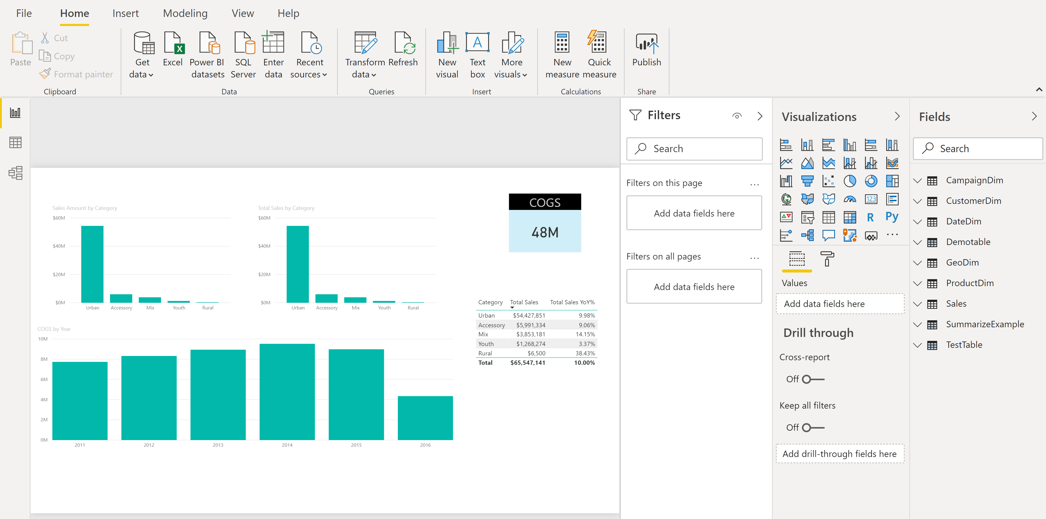
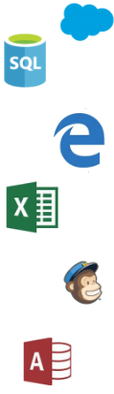

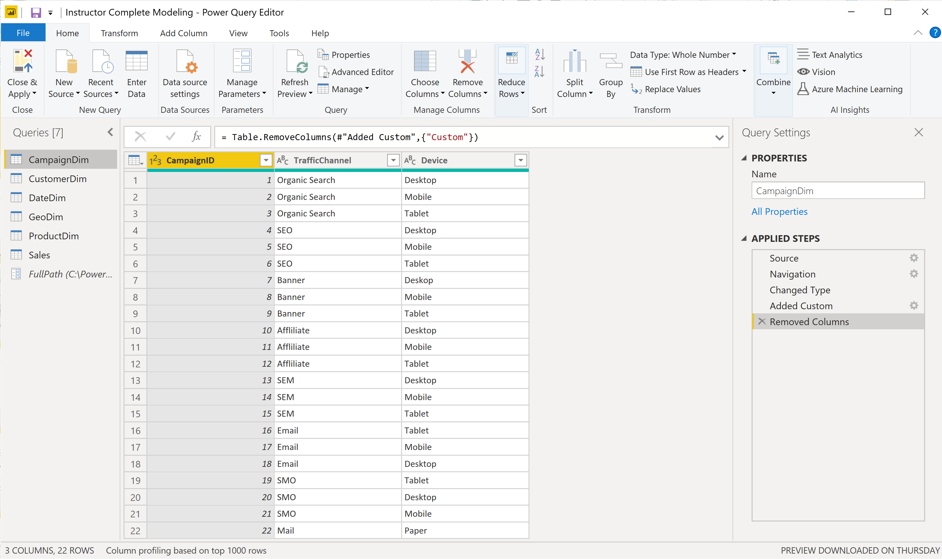
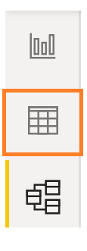
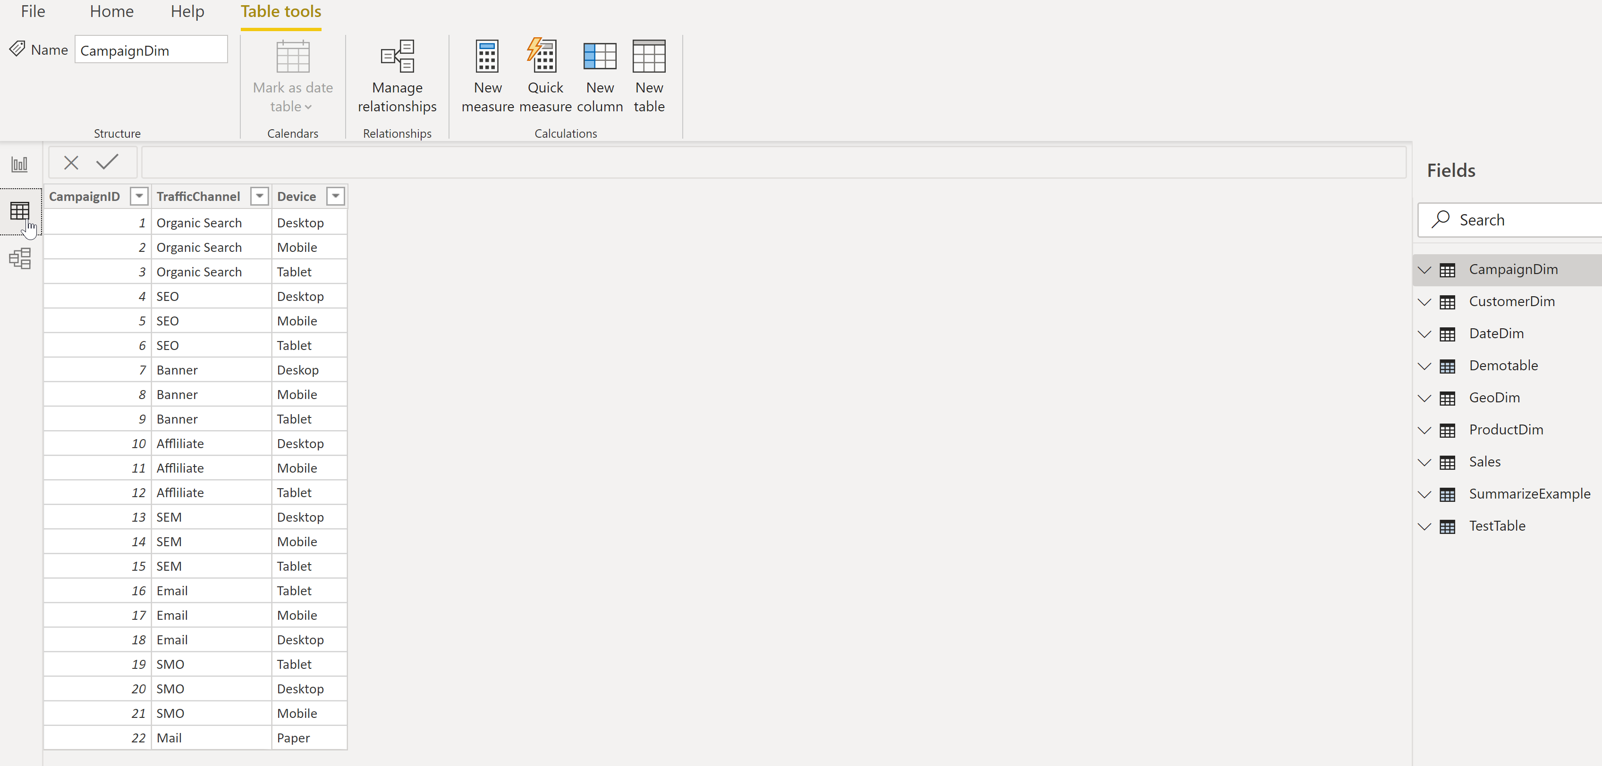

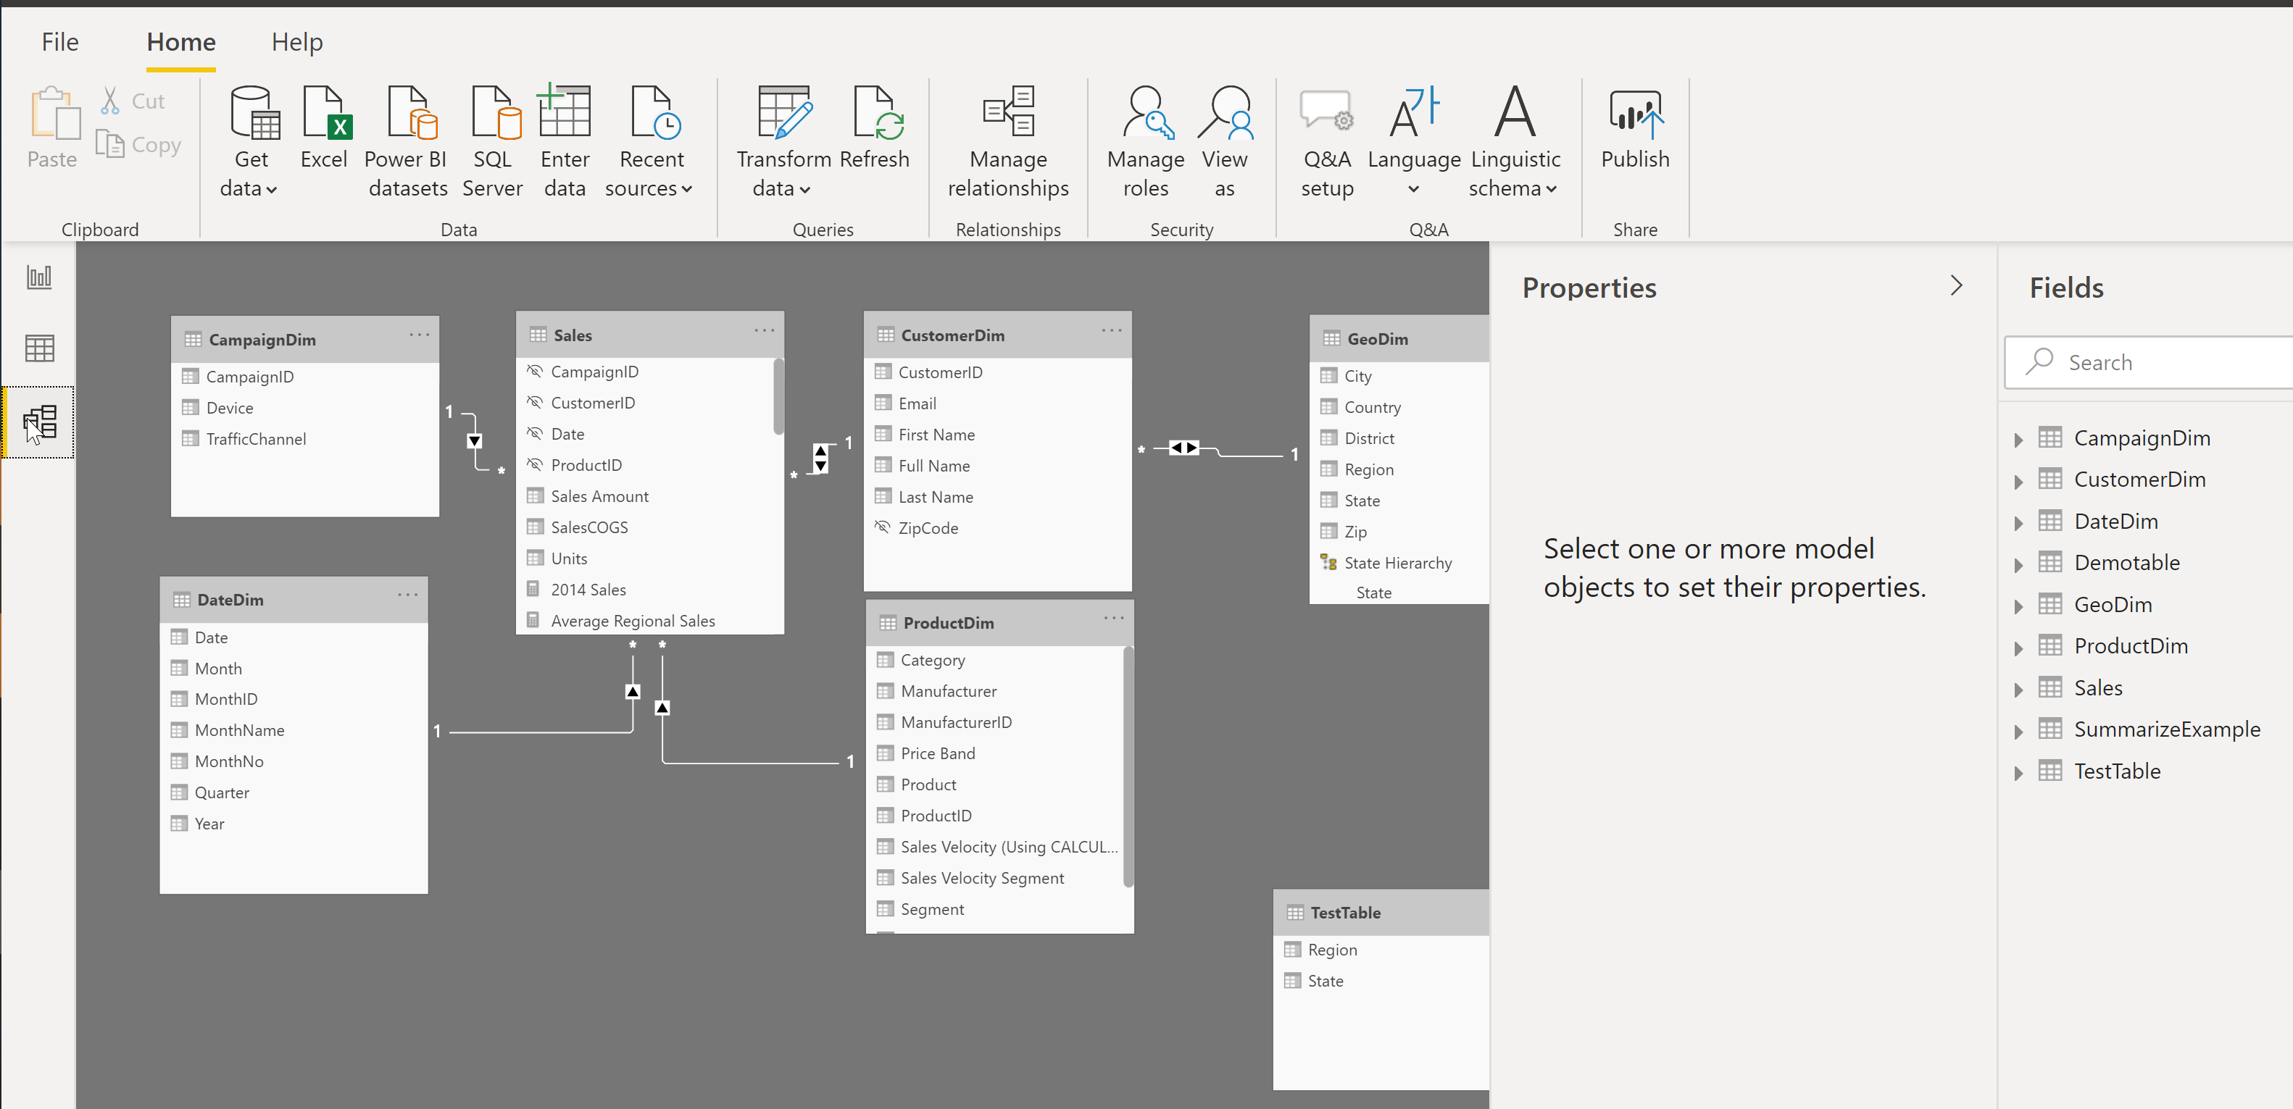

Power BI Desktop Data Flow
Power BI Desktop file
Data Sources
Report
Create Visuals
Close & Apply
Close: Closes Query Editor
Apply: Loads data from sources to Data Model
Data (DAX)
View Tables
Query Editor (M)
Data Source Connections
Data Transformations
(Prep data for Data Model)
Relationships
See how Tables relate to each other
© 2020 Microsoft. All rights reserved.
Notes:
This build slide emphasizes that the Query editor is for transformations and is a different window than the primary modeling views.

Slide 10
What is a Data Model
A Power BI Data Model is a collection of tables with relationships which enable your business users to easily understand and explore their data to get business insights.
Why is it important to have a Good Data model?
Improves understandability of the data
Increases performance of dependent processes and systems
Increases resilience to change
© 2020 Microsoft. All rights reserved.
Notes:
In a good Data Model, the model can assume that column types are homogeneous (as they are strongly typed). This is different from Excel, where any given cell in a spreadsheet can contain different data types.

Slide 11
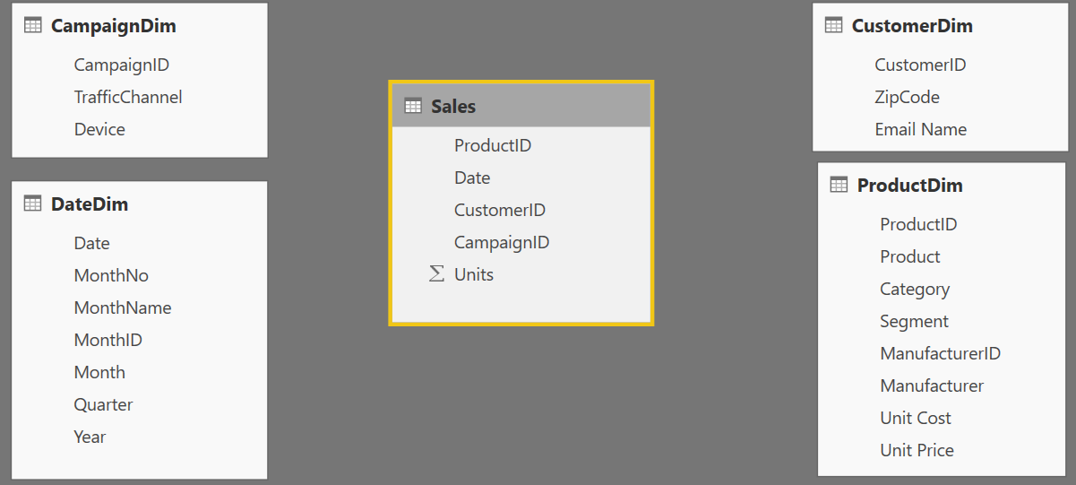
Components of a Data Model – Fact Table
Fact
Table
Fact Table
Contains Measures (or items to be aggregated) of a business process Examples:
Transactions
Sales Revenue
Units
Cost
Measures are usually sliceable.
Examples: By Month,
By Customer
© 2020 Microsoft. All rights reserved.
Notes:
This slide builds automatically.
Depicts the data flow for Power BI Desktop along with what is in a PBIX file.
Note all the data sources that can be pulled into Query Editor.
Not the different views (Report, Data, Relationships) once all of the data is pulled in.
Ask about Fact tables
Mention Kimball
Measures to improve the scale overall

Slide 12
Components of a Data Table – Dim Table
Dim
Tables
Dim
Tables
Dim Table
A Dim (or Dimension) table contains descriptive attributes that define how a fact should roll up.
Examples:
By month, By Customer, By Geo
Notes:
The BY’s will be the dimensional attributes that we will use to describe the facts.

Slide 13

Components of a Data Table - Relationships
Relationships
Connection between a 2 tables (usually fact & Dim tables) using columns from each
3 kinds of Relationships
1 to Many
1 to 1
Many to Many
(with a bridge table)
Relationships
Relationships
© 2020 Microsoft. All rights reserved.
Notes:
A Relationship is analogous to how an Excel VLOOKUP function brings two tables together
Can observe which side is the many (*) and which is the one (1) - CARDINALITY
When you draw the relationship, Desktop does several heuristic things
It checks that one side of the relationship is the “One” and the other is the “Many”
Directions of Relationship
Uni-directional are created by default and allows filters to get passed from attribute (dim) table to the Fact
Bi-Directional relationship allow you to pass filters in both directions
This is different than Many to Many
There is a significant performance penalty for Bi-Directional filtering

Slide 14
Data Model Brings Facts & Dimensions Together
Type of Data Models
Star Schema
Snowflake Schema
Flat or Denormalized
Note: This is not an exhaustive list, but are the most common model types used by Power BI.
© 2020 Microsoft. All rights reserved.
Notes:
Flat or denormalized schema for the data model
Ask if anyone knows audience engagement

Slide 15
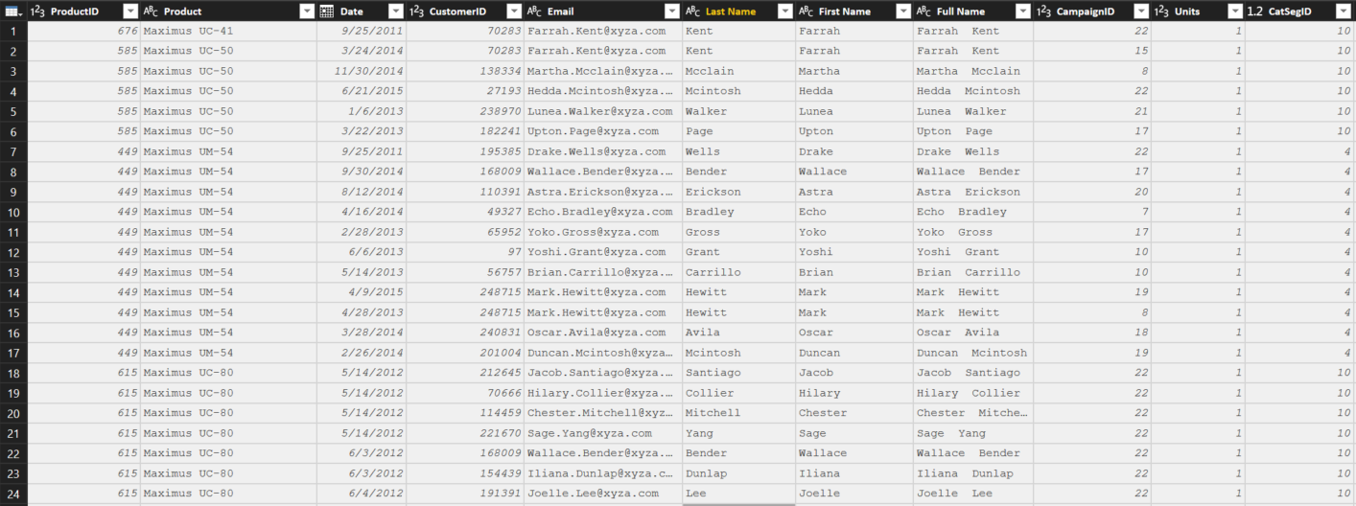
Flat or Denormalized Schema
All attributes for model exist in a single table
Highly inefficient
Model has extra copies of data > slow performance
Size of a flat table can grow and quickly “blow up” as data model becomes complex
© 2020 Microsoft. All rights reserved.
Notes:
Like Excel with many V-Lookups
Denormalized are flattened versions where all attributes are copied into the same table
This is a requirement of a certain “T” competitor – and a major differentiator in the market
If denormalize everything than it is a problem computing time will be very long
Update the slides – for the specific product, review the slide

Slide 16
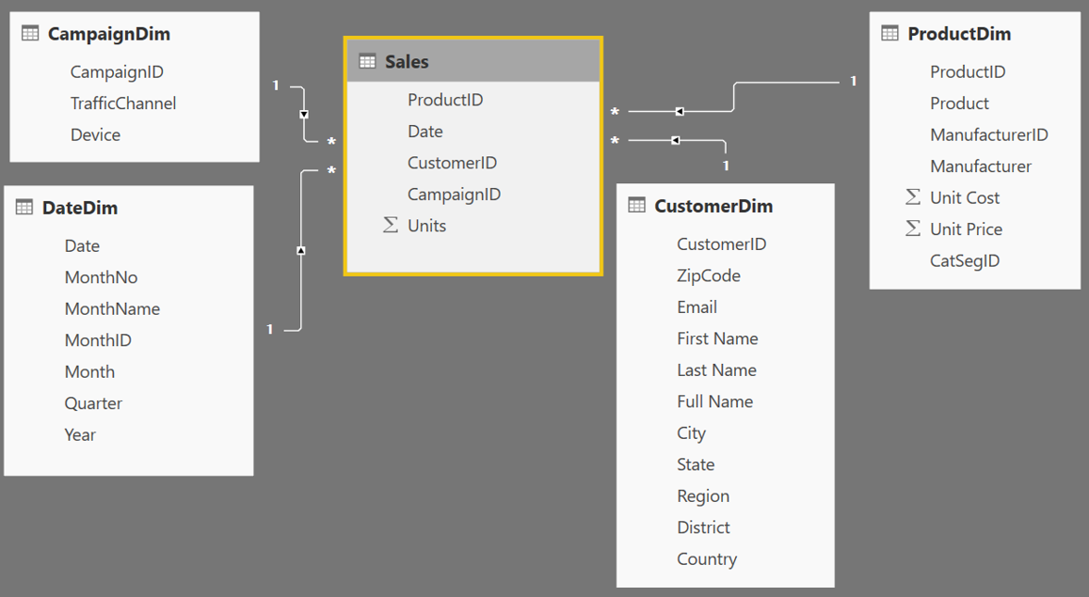
Star Schema
1
Many
1
1
Fact table in the middle
Surrounded by Dims
Looks like a ‘Star’
Fact table is the “Many” side of the (one to many) relationship
© 2020 Microsoft. All rights reserved.
Notes:
By extracting the repeated attributes to dimension tables, you are lowering the amount of memory required by the data model.

Slide 17

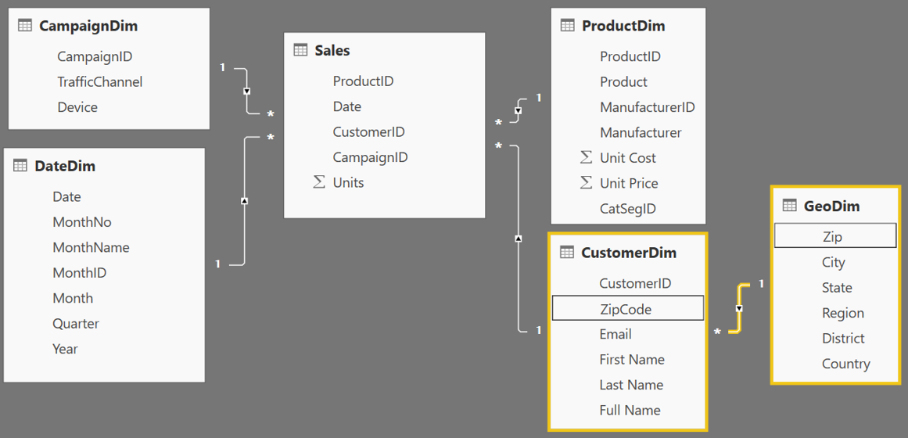
Snowflake Schema
Center is a Star schema
Fact table in middle
Surrounded by Dims
Dims “snowflake” off of other Dims
If you have many, it looks like a ‘Snowflake’
Dim or Fact tables can be the “Many” side of the relationship
Dims
Facts
Dims
Flake
© 2020 Microsoft. All rights reserved.
Notes:
“Snowflaking” off tables can be very beneficial when your dimensions have several repeating attributes that can be extracted to their own table.
A zip code is associated with multiple attributes
Talk about your own zip code and the richness associated with that particular zip

Slide 18
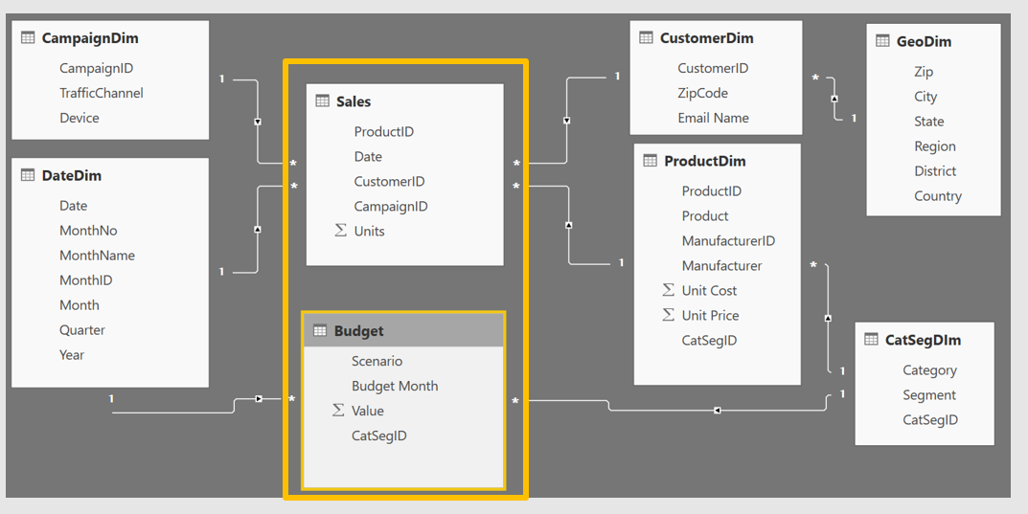
COURSE AGENDA
Grain (granularity) measures the level of detail in a table
Example:
One row per order or per Item
Daily or Monthly date grain
If your facts have very different granularities, split them into Multiple Fact tables & connect them to shared dimensions at the lowest common granularity.
Sales (Daily by Product)
Budget (Monthly by Product Category & Product Segment)
Notes:
Keep in mind, your measures (calculations) should be placed on a fact table, but it really does not matter which one. The key is that measures should not be placed on dimension tables.
When you have a fact at the Month grain, like budget, you can create a calculated column which holds the first (or last) day of the month to use in creating the relationship.
Emphasize that if the month id is unique a join can happen

Slide 19
Demo 1
Notes:
Go through the powerbi desktop tool
10 -15 minutes to explain

Slide 20



How can I tell what Data Model Type I have?
Data Model Types in Power BI
Live Connect to SQL Analysis Services (SSAS) tabular
Report view only available
DirectQuery to SQL or other relational source
Report & Relationship views available
Import data into Power BI (creates a copy of the data)
Report, Data and Relationship views available
Notes:
Quick note with 2 pictures Black Nav bar that shows a live connect doesn’t have the relationship or the data tab
Direct Query doesn’t have the Relationship option
Power BI currently supports both of the models

Slide 21
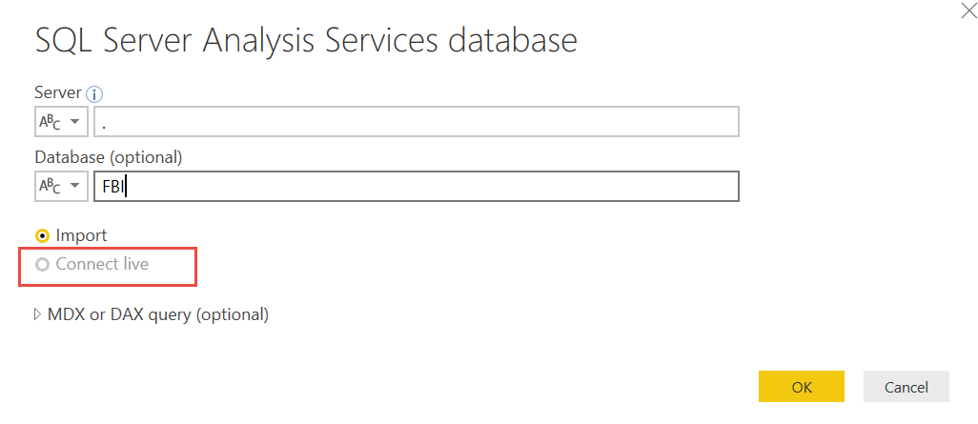
Connection: LiveConnect
Live Connect to Multidimensional or Tabular
On Premise or Azure
Only a single connection will be made and all modeling is done in the cube
You can not add relationships or additional data source
If allowed, you can add DAX measures

Slide 22
Choosing Storage Mode: LiveConnect
Mode used when Power BI model accessing an SQL Server Analysis Services (SSAS) data model
Can be a server (IaaS) or Azure Analysis Services (PaaS)
When is it appropriate
Organization has already invested significantly in SSAS, have mature models
High level of control needed around partitions, data refresh, query scale-out and workload splitting
Granular auditing, monitoring and diagnostics
Integration with CI/CD or similar automation pipelines
Models can’t fit in Premium (P3+ models up to 10GB v. no overall model size limit in SSAS)
Considerations
Strategically we will be bringing AS features to Premium over time
We can enable certain features per customer (e.g. Aggregations in ASAzure)

Slide 23
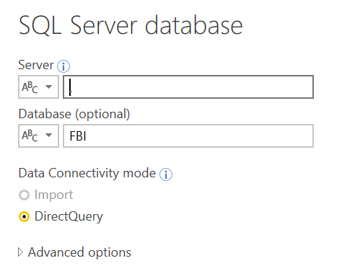
Connection: DirectQuery to RelationalSource
Direct Query to SQL or other relational source
On Premise or Azure
Composite modeling is possible where some data sources are in Direct Query mode and a few are in Import mode
You can add relationships and DAX
Notes:
Combining Direct Query and import in a single Power BI dataset is supported (composite modeling).
A few things to consider:
Removing fields—best practice is that if it isn’t a field you’re reporting on, think very carefully about whether it needs to be included in the model
Reducing the number of text fields with many unique values—see this whitepaper (https://msdn.microsoft.com/en-us/library/dn393915.aspx) for more information on how tabular models compress data and what you can do to identify the worst offending fields and optimize compression or performance
Reducing the date range of data being brought in—it is common to see business users want to bring in all historical data—it’s worth asking whether their business has fundamentally changed in the last X years where trends from before X years are not relevant

Slide 24
What is unique about Power BI Desktop in Import Mode?
Import Mode
Columnar database
In-memory database
Let us understand some of the internals of Power BI Desktop !!

Slide 25
Choosing Storage Mode: Import vs DirectQuery
Import is your first choice (all in memory = best speed, no DAX limits)
When is it inappropriate
Extremely large data volumes
Need near real-time access to data from source
Considerable existing investment in external DW or OLAP (modelled, conformed, cleaned, calcs defined etc). SSAS MD, SAP HANA and BW are common.
Regulatory and data sovereignty requirements
Considerations
How much source data, how compressible? Rule of thumb is 5x-10x
Is Premium an option? (larger datasets supported there)
Will blended architecture suffice? (Composite models, Aggregations for summary data)
Some limits on DAX in DirectQuery mode (e.g. time intelligence)
© 2020 Microsoft. All rights reserved.
Notes:
It’s worth mentioning that the product team recommends DQ mode only in situations where low latency is the driving factor. If you have a situation where import is resulting in too large of a dataset, you should consider optimizing the data you are pulling into better take advantage of the tabular model’s in-memory columnar datastore that’s running in Power BI’s back end.
*************************************
Mention the live connect
Max capacity of usingPower BI– 12G
Premium to each core – slide updated by Siva
Reason to use analysis services – large amount of data
Data refresh frequency

Slide 26
Columnar Database
Row Based Database
PBI - Columnar Database
First Name | Last Name | Sales
John | Smith | $10
Jane | Doe | $25
Hardy | B | $35
First Name | Last Name | Sales
John | Smith | $10
Jane | Doe | $25
Hardy | B | $35
Stores each row separately (like a separate file)
Retrieving multiple columns from a single row is fast
Retrieving multiple rows from a single column is slower
Stores each column separately (like a separate file)
Retrieving multiple columns from a single row is slow
Retrieving multiple rows from a single column is faster
Columnar databases are well suited for analytics
© 2020 Microsoft. All rights reserved.
Notes:
Separate file for the row oriented

Slide 27
In-Memory Database
PBI – In-Memory Database
Data stored in RAM (in memory)
RAM is all electronic – Read/Write is fast
Laptops have smaller RAM space (~8GB)
Power BI compresses data to conserve space in RAM
© 2020 Microsoft. All rights reserved.
Notes:
Every Row is stored in a separate “File”
How many files do I open to get the “total Sales”?
For ANALYTICAL - To get the total sales – it will only need to open ONE File
* Column based architecture is better for Analysis

Slide 28
How Power BI Compresses Data – Dictionary Encoding
Compressing Data – Dictionary Encoding
Sale Id | Color | Sales Amount
390a30e0-dc37 | Red | $10
390a30e1-dc37 | Green | $25
390a30e2-dc37 | Red | $35
390a30e3-dc37 | Red | $15
390a30e4-dc37 | Red | $25
390a30e5-dc37 | Green | $30
390a30e6-dc37 | Blue | $10
390a30e7-dc37 | Blue | $12
390a30e8-dc37 | Blue | $15
390a57f0-dc37 | Blue | $18
390a57f1-dc37 | Green | $25
Red = 1 Green = 2 Blue = 3
Create a Dictionary to create an integer value for text string
Storing 1,2,3 instead of “Red”, “Green”, “Blue” saves memory
Dictionary encoding is powerful when there are few unique values in a column
Ex. Color column – Good for dictionary encoding
Ex. Sale ID – Bad for dictionary encoding
© 2020 Microsoft. All rights reserved.
Notes:
We tend to be data “Hogs” - which columns do you really need?
In a proper Star Schema, Dictionary Encoding would primary affect Dimension table, or text fields on Fact table (of which there should be few, if any).

Slide 29
How Power BI Compresses Data – Run Length Encoding
Compressing Data – Run Length Encoding
Sale Id | Color | Sales Amount
390a30e0-dc37 | Red | $10
390a30e1-dc37 | Green | $25
390a30e2-dc37 | Red | $35
390a30e3-dc37 | Red | $15
390a30e4-dc37 | Red | $25
390a30e5-dc37 | Green | $30
390a30e6-dc37 | Blue | $10
390a30e7-dc37 | Blue | $12
390a30e8-dc37 | Blue | $15
390a57f0-dc37 | Blue | $18
390a57f1-dc37 | Green | $25
1
2
1
1
1
2
3
3
3
3
2
Run Length Encoding in Power BI
Instead of storing - 1, 2, 1, 1, 1, 2, 3, 3, 3, 3, 2
It Stores:
Run length encoding is very powerful when data is sorted well and has few unique values
Where Red = 1 Green = 2 Blue = 3
© 2020 Microsoft. All rights reserved.
Notes:
Image compression technique which is used to compress black and white images. The PowerBI team is using this same Run Length compression.
If you have 10,00 TRUEs then 10,000 FALSEs, it will provide the best compression of the column
Memory compression and performance are directly related
Mention Kaspers’ calculation blog post to find out how your memory is used. (Link in Post)

Slide 30
Practical Example of Compression
Compression
Dashboard in a Day Class Data
DIAD Complete Data Model
Sales Fact | 420.0 MB
Dimensions | 4.4 MB
Int’l Sales | 32.4 MB
Total Data | 456.8 MB
Data Model | 59.4 MB
Almost 8X Compression!!
Queries ONLY – No Data Loaded
Query Metadata | 113 KB
© 2020 Microsoft. All rights reserved.
Notes:
* When the file is closed – it is saved to the hard disc
When opened, the DB is stored in RAM (Approx 60% of machine’s available RAM)
Hard Disk has mechanical parts - read/writes are slower
In-Memory – read/writes are faster
RAM is precious, and the PowerBI team uses many techniques to compress data
In the Service, datasets are limited to 1 GB.

Slide 31
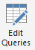

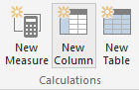
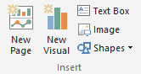
Phases in Building a Power BI Desktop File
Power BI Desktop Files
“Get Data” Phase
Model Creation Phase
Model
Enhancement
Phase
Visual
Building Phase
Compress data, auto detect relationships
(Automatically done by Tool)
Add calculated columns, measures, add missing relationships
Create Query in “M”
Evaluate Measures and build each visual
© 2020 Microsoft. All rights reserved.
Notes:
Should be 1 hour into the training at this point
In Power BI desktop connect to Raw Data Excel file that contains all data for the Power BI model. Pull Sales Fact , Geo and Date
Show the Get data phase
Show how if you do apply later and save just the “Query information” is saved
If you apply data – Data transformation changes are saved (All data is loaded, and most relationships are created)
Add a relationship for the date column
Show how you can add a calculated column and measure
Calc Column on Product Dimension: Price Band = IF(ProductDim[UnitPrice]> 10, “High”, “Low”) – memory inefficient – less optionally compressed as is not sorted
Measures: Total Sales = Sum(SalesFact[Sales]) – no result yet – as a measure is ONLY calculated when a visual is built
Finally build a few visuals and show how the measures are evaluated during visual building phase – you can start with a simple matrix to check values
Process Time Vs. Query Time
Time to take to process the model (Process) includes all calc columns
Time to build a Visual (Query) includes measures

Slide 32
Data Types
Numeric Data Types
Whole Number
Decimal Number
Fixed Decimal Number (Floating point stored as integer)
Boolean
Date/Time Data Types
Date – Internally stored as an integer
Time – Internally stored as a fraction between 0 and 1
Date Time
Other Data Types
Text
Any – You should never see this in a data model. Bad things can happen!!
Set your Data Types in the Query Editor
Set your Data Formats ($ %, etc) in the Data Model
Pro Tip: Data type is different from data format
© 2020 Microsoft. All rights reserved.
Notes:
Data Types are how data is stored, as opposed to Data Formats which are how data are displayed
Discuss the difference between Fixed Decimal (Currency) and Decimal (which has floating decimal)
Fixed Decimal is 19.4 – 19 places to left of decimal and 4 to the right, which allows for proper processing of pennies. Best for Currency numbers.
Decimal can be less efficient when the data has excessive precision
Discuss splitting DateTime into Date and Time columns so that they compress better
Fixed Decimal numbers – stored like whole number uses less memory than Decimal

Slide 33
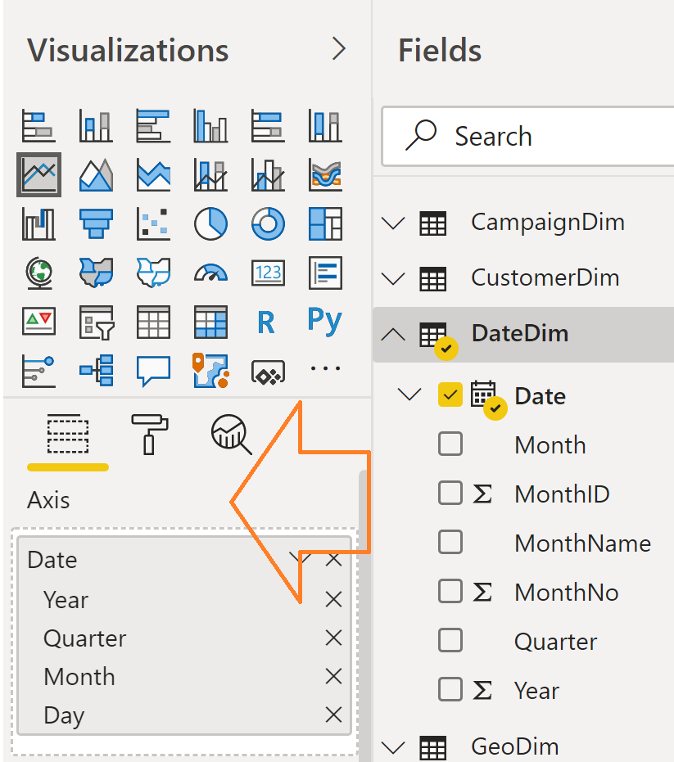
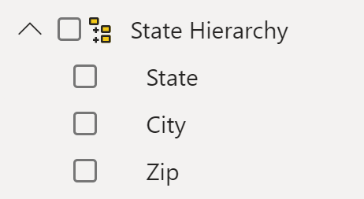
Hierarchies
Power BI generates Date hierarchies when dates are added to visuals, this allows the end user to drill from Year, Quarter, Month & Day.
Users can also create custom hierarchies in the model by dragging a lower level field onto the parent.
© 2020 Microsoft. All rights reserved.
Notes:
Can approximate hierarchies in the drill path of a visual

Slide 34
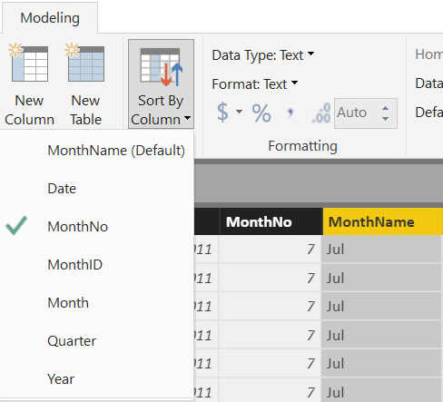
Sort By Column
Enables sorting one text field by another (numeric) field
Both columns must have the same number of distinct values
© 2020 Microsoft. All rights reserved.
Notes:
Sort by Column was shown in DIAD, but it is important modeling concept to know.
This is applied in the Data section of the model.

Slide 35
Aggregations
Using aggregations in Power BI enables interactive analysis over big data. Advantages of aggregation are:
Query performance over big data
Data refresh optimization
Achieve balanced architectures
© 2020 Microsoft. All rights reserved.
Notes:
Query performance over big data - as users interact with visuals on Power BI reports, DAX queries are submitted to the dataset. Boost query speeds by caching data at the aggregated level, using a fraction of the resources required at the detail level. Unlock big data in a way that would otherwise be impossible.
Data refresh optimization - reduce cache sizes and refresh times by caching data at the aggregated level. Speed up the time to make data available for users.
Achieve balanced architectures - allow the Power BI in-memory cache to handle aggregated queries, which it does effectively. Limit queries sent to the data source in DirectQuery mode, helping stay within concurrency limits. Queries that do get through tend to be filtered, transactional-level queries, which data warehouses and big-data systems normally handle well.
https://docs.microsoft.com/en-us/power-bi/desktop-aggregations

Slide 36
Lab 01
Open the files:
Data Modeling Labs Student Modeling Pre-class.pbix
Complete the 1st Lab 01 – Create Relationships between tables
© 2020 Microsoft. All rights reserved.
Notes:
What happens when you drop a Calculated column in a Values section – DAX implicitly calculates a measure on top of it. It is a bad thing because you did not tell DAX what to do and DAX just assumed that you wanted to do something with it.
Ex. Drop Profit in Sales

Slide 37
KNOWLEDGE CHECK Module 1
What is a data model in the context of Power BI?
What are some advantages of a star schema over a flat or denormalized model?
How might you improve the performance of a Power BI model?
How does Power BI store DateTime information? What are some consequences of this?
© 2020 Microsoft. All rights reserved.

Slide 38
Power BI Data Modeling in a Day
Module 2
Data Modeling Best Practices

Slide 39
MODULE 2 OBJECTIVES
Understand importance of query folding
Re-emphasize learnings of data compression techniques
Re-emphasize the use of relationships
© 2020 Microsoft. All rights reserved.

Slide 40
Data Modeling
An inefficient model can completely slow down a report, even with very small data volumes
GOALS
Make the model as small as possible
There are valid reasons to bend this rule
Schema supports the analysis
Relationships are built purposefully and thoughtfully
© 2020 Microsoft. All rights reserved.

Slide 41
Move Calculation to the Source
Scenario
Many DAX calculated columns with high cardinality
Why is it undesired?
Calculated columns don’t compress as well as physical columns
Proposed Solution
Perform calc in Power Query, ideally push down
Customize source query for non foldable transforms
© 2020 Microsoft. All rights reserved.
Notes:
This slide emphasis learnings from Slide 26-28 – importance of compression

Slide 42
Remove Unused Table and Columns
Scenario
Model contains tables/columns that are not used for reporting/analysis or calculations
Why is it undesired?
Increases model size
Increases time to load into memory
Increases refresh time
May affect usability
© 2020 Microsoft. All rights reserved.
Notes:
This slide emphasis learnings from Slide 26-28 – importance of compression

Slide 43
Avoid High Precision/Cardinality Columns
Scenario
Model contains columns at a higher precision than needed for analysis e.g. datetime in milliseconds, weight to 6 decimal places
Model contains columns that are highly unique
Why is it undesired?
Less compression with high precision/cardinality
Increases time to load into memory
Increases refresh time
Proposed Solution
Remove if not needed
Reduce precision
Split datetime into date and time
© 2020 Microsoft. All rights reserved.
Notes:
This slide emphasis learnings from Slide 26-28 – importance of compression

Slide 44
Use Integers instead of Strings
Why is it undesired?
Strings use dictionary encoding, integers use run length encoding which is more efficient
Proposed Solution
Check data types and set to integer if known to be numerical
© 2020 Microsoft. All rights reserved.
Notes:
This slide emphasis learnings from Slide 26-28 – importance of compression

Slide 45
Use Integer Surrogate Keys, Pre-sort them
Power BI compresses rows in segments of millions of rows
Integers use Run Length Encoding
Sorting will maximize compression when encoded as it reduces the range of values per segment
© 2020 Microsoft. All rights reserved.
Notes:
This slide emphasis learnings from Slide 26-28 – importance of compression
Default Segment Sizes:
AS Azure: 8 million
SSAS: 8 million
Premium: 1 million
Shared: 1 million
PowerPivot: 1 million

Slide 46
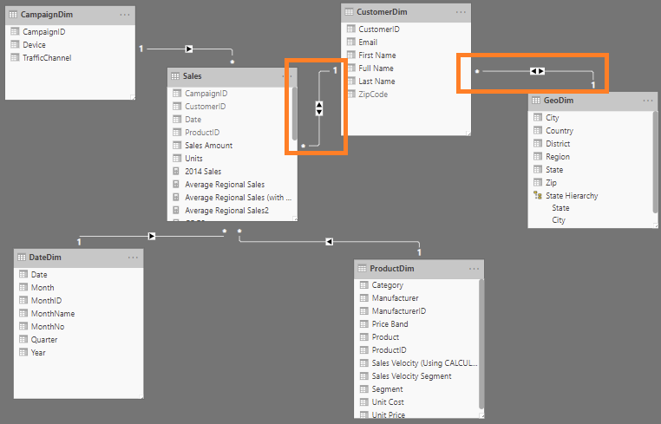
Be Careful with Bi-Directional Relationships
Scenario
Most relationships in the model are set to bi-directional
Why is it undesired?
Applying filters/slicers traverses many relationships and can be slower
Some filter chains unlikely to add business value
Proposed Solution
Only use bi-di where the business scenario requires it
© 2020 Microsoft. All rights reserved.
Notes:
This slide emphasis learnings from Slide 12– use bi-directional filtering with caution

Slide 47
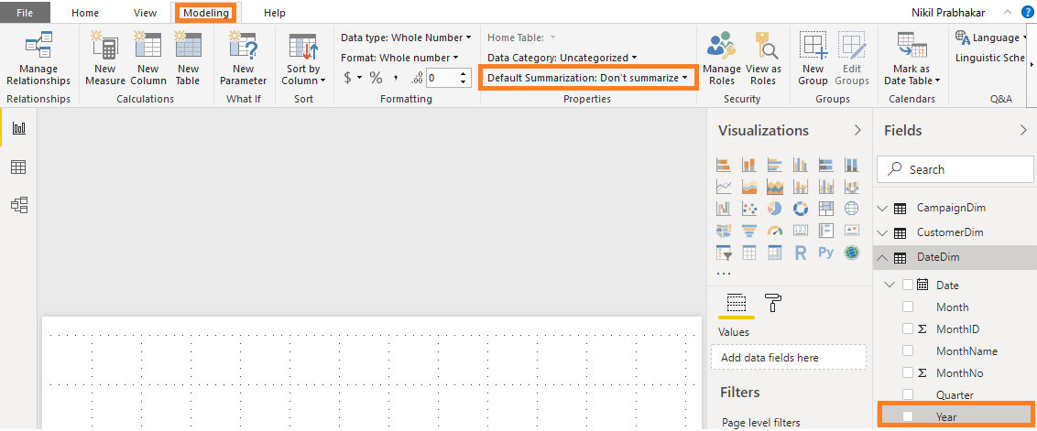
Set Default Summarization
Scenario
Numeric columns in model that are purely informational (e.g. Account ID)
Default summarization is Sum
Why is it undesired?
Power BI will try to sum the number when dropped into visuals.
Detailed tables/matrixes can be slower
Proposed Solution
Set the default summarization to None
© 2020 Microsoft. All rights reserved.
Notes:
Fields like Year, which are numeric, but you do not want to summarize, set the global Default Summarization on the Modeling Ribbon
We will deep dive into default summarization in Slide 62

Slide 48
Consider Subsets for very large models
Scenario
Large model – hundreds of tables and tens of GB
Large high grain fact tables – millions to billions
Why is it undesired?
Aggregating/measures across large facts can affect performance
Large models become harder to maintain and use ad-hoc
Proposed Solution
Consider aggregations and composite models features
Build manual summary tables with smart measures
Create smaller models for the most common business cases
© 2020 Microsoft. All rights reserved.
Notes:
Companies build a mega model to answer all questions. If you build one mega model – model becomes extremely large impacting performance (both in shared and premium capacity).
In this scenario – might be good idea to break down the model into smaller models. Maybe Exces use smaller subset or aggregated data. So it maybe be a good idea to break model based on consumers and have multiple models answering different questions at different levels.
Not covered here – In Power BI Service maybe good idea to have a Premium workspace for Exces and different workspace for others.

Slide 49
Key takeaways to design a good Power BI Desktop data model
Designing Good Data Models
RAM is precious !!!!!
Some Tips and tricks to save RAM and increase speed of model
If a fact table contains an ID field which is unique for each record, remove it
Ex. Transaction ID
Sort columns before bringing them into a Power BI data model
The DateTime data type is usually not needed, unless you are specifically using the Time component
If you really need Time, try splitting Date & Time into two columns - Reduces # of unique values
Star Schema – Good for most Data Models
PowerBI Monitor
© 2020 Microsoft. All rights reserved.
Notes:
* When the file is closed – it is saved to the hard disc
When opened, the DB is stored in RAM (Approx 60% of machine’s available RAM)
Hard Disk has mechanical parts - read/writes are slower
In-Memory – read/writes are faster
RAM is precious, and the PowerBI team uses many techniques to compress data
In the Service, datasets are limited to 1 GB.

Slide 50
KNOWLEDGE CHECK Module 2
Which of these help with compression of data and performance?
Using integers instead of strings
Using high cardinality columns
Move calculations to data source
Remove unused tables and columns
© 2020 Microsoft. All rights reserved.

Slide 51
Power BI Data Modeling in a Day
Module 3
DAX Calculated Columns & Measures

Slide 52
MODULE 3 OBJECTIVE
Understand differences between calculated columns and measures (uses, evaluation, performance, etc.)
© 2020 Microsoft. All rights reserved.

Slide 53
DAX Level Set
DAX looks similar to Excel functions but they have key differences
DAX is a very deep and elegant…
This class provides a solid base in DAX, but don’t expect to leave being able to write the most complex DAX patterns--they take practice.
© 2020 Microsoft. All rights reserved.
Notes:
Let’s be real.
- DAX is easy to get started with (due to similarity to Excel)
- DAX mastery takes a lot of time to acquire
- Subtle differences in DAX formulas can have profound results!

Slide 54
Path to DAX Expertise
DAX Foundations
Evaluation Contexts
CALCULATE
Calculated Columns and Measures
© 2020 Microsoft. All rights reserved.
Notes:
Even though this class is 200 this is really a 100 level DAX class
DAX answers are not “one size fits all” – we are trying to help you find some hidden gems

Slide 55
DAX Foundations
Calculated Column
Measure
© 2020 Microsoft. All rights reserved.
Notes:
Calculated Columns and Measures are both written in the DAX Language.
A Calculated Column is evaluated as a new column in the table in which it resides and will not change value until the underlying data is refreshed.
Measures are calculations which do not have a result until they are used in a visualization. They may use sums, averages, minimum or maximum values, counts, or more advanced calculations; and they change value in response to your interaction with your reports.

Slide 56
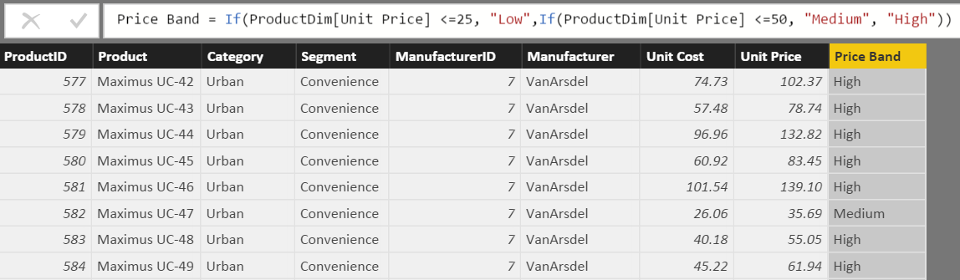
What is a Calculated Column
Calculated Column
Pro Tip: Always refer to a calculated column by its full name -> TableName[ColumnName]
© 2020 Microsoft. All rights reserved.
Notes:
Used to add attributes that don’t exist in the source data
See this formula. This looks a lot like Excel
Demo:
In Product Dim Table add the above formula from the Tab called “Calculated Column”

Slide 57
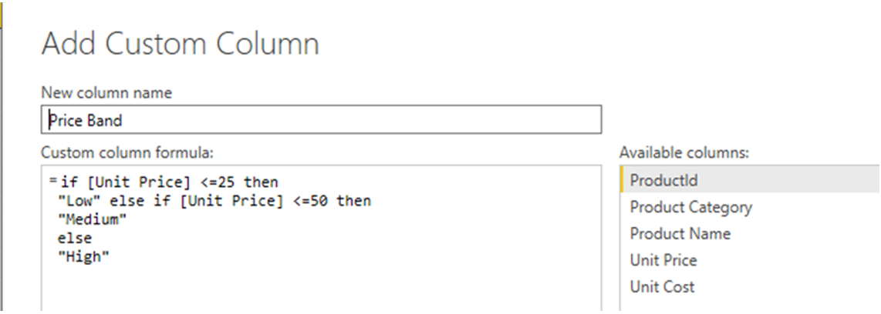
Calculated Column in DAX
Calculated Column
Custom Column in “Query Editor”
Note: If given a choice, creating the column in “M” or “Query Editor” will give you better compression.
© 2020 Microsoft. All rights reserved.
Notes:
DEMO: If a question comes up related to how to create a calculated column in ”M”, then do the following:
Open Query editor and create a calculated column using this formula:
if [Unit Price] <= 25 then "Low" else if [Unit Price] <=50 then "Medium" else "High“ M is case sensitive and the if/then/else syntax is different than Excel/DAX
Instructor Talking Point, if needed:
Once the column comes in it becomes like any other column in Power BI Desktop file
The column is compressed
There is a secondary processing for Calculated Columns – Which makes process times slower

Slide 58
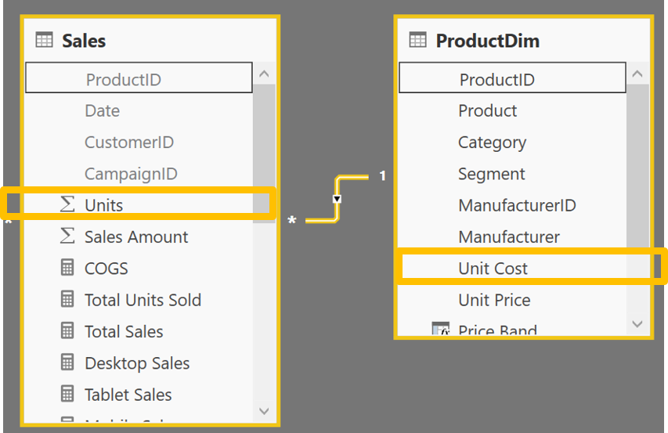
Calculated Column – Accessing columns from other Tables in model
Calculated Column
Often you want to access columns from multiple tables to create a Calculated Columns
Let us say you want to calculate COGs, which is Units * Units Cost
Units Cost is in another Table
© 2020 Microsoft. All rights reserved.

Slide 59
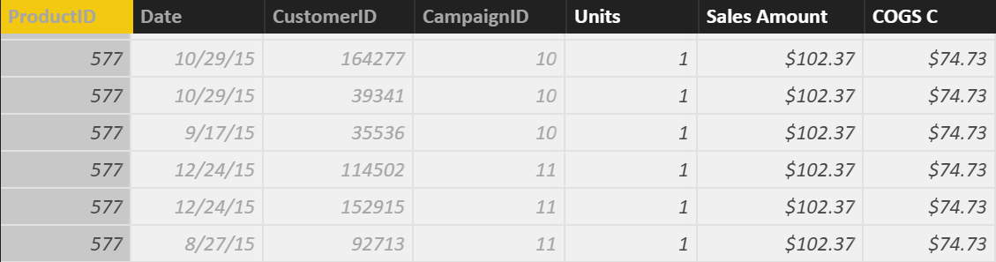
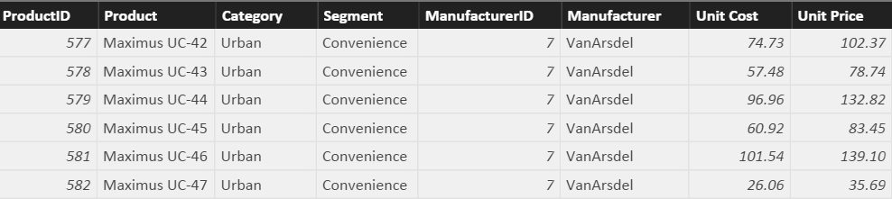
Row Context and Multiple Tables – RELATED Function
RELATED Function
Sales[COGS] = RELATED(ProductDim[Unit Cost]) * Sales[Units]
RELATED is just like VLOOKUP in Excel
© 2020 Microsoft. All rights reserved.
Notes:
First Bring in the column. Let it resolve and then multiply
Demo:
In SalesFact Table write this formula: Sales[COGS] = RELATED(ProductDim[Unit Cost]) * Sales[Units]
(also available in Calculated Column Tab)
Note to instructor: Just like Vlookup but without all of the drama – No NA()

Slide 60
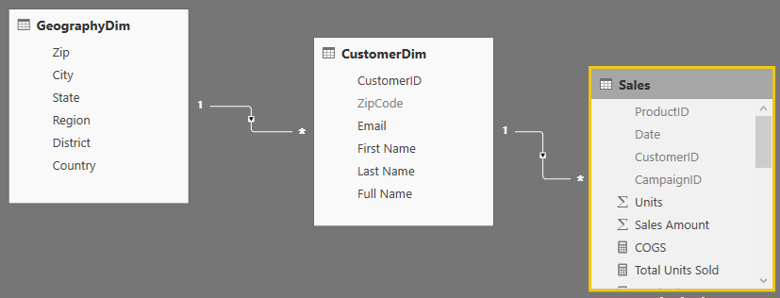
RELATED Function Example
RELATED Function
You could follow a chain of relationship from Many side to 1 side using RELATED
Sales [City State]= RELATED(GeographyDim[City]) & “, ” & RELATED(GeographyDim[State])
© 2020 Microsoft. All rights reserved.
Notes:
This is an example of “Just because you can, does not mean you should”
Creating a calculated column like this on the fact table takes way too much memory when it could just as easily be placed on the GeographyDim table.
No Demo on this slide
Note to Instructor: If you need to aggregate back from 1 side to the Many side, there is a companion formula called RelatedTable – but we will cover that later.

Slide 61
When is a Calculated Column Evaluated?
DAX Foundations
“Get Data” Phase
Model Creation Phase
Model
Enhancement
Phase
Visual
Building Phase
Create Query in “M”
Compress data
Auto detect relationships
Add calc. columns, Measures
Add missing relationships
Evaluate Measures and build each visual
© 2020 Microsoft. All rights reserved.
Notes:
Note to Instructor: This has already been covered and is just reinforcing a concept covered in a previous slide.

Slide 62
Best Practices with DAX Calculated Columns
Best Practices – Calculated Column
Whenever possible, DAX helper columns should be avoided. Each “Helper Column” will consume RAM
Create a calculated column in the Dim Table as opposed to in the Fact Table
Move calculated columns to “M” if you can
© 2020 Microsoft. All rights reserved.
Notes:
Instructor Talking Point,
Best Practice is to create a calculated column at the HIGHEST level of granularity - in the highest dim

Slide 63
DAX Foundations
Calculated Column
Measure
© 2020 Microsoft. All rights reserved.
Notes:
Instructor Note: From the Definitive Guide to DAX (Russo, Marco and Ferrari, Alberto)
Calculated Column is just like any other column in a table and you can use it in rows, columns, filters, or values of a pivot table or any other report. You can use it to define a relationship, if needed. The DAX expression defined for a calculated column operates in the context of the current row of the table to which it belongs. Any reference to a column returns the value of that column for the current row. You cannot directly access te values of other rows. – Important concept is that a Calculated Column is computed during the processing and then stored into the model. The Calculated Columns occupy space in memory.
Measures are another way to define calculations but when you do not want to compute values for each row but, rather, you want to aggregate values from many rows in a table. A measure needs to be defined in a table but does not really belong to the table and can be moved from one to another without losing its functionality.
Differences between calculated columns and measures – even if they look similar, there is a big difference between these. The value of a Calculated Column is computed during data refresh and uses the current row as a context; it does not depend on user activity on the pivot table. A measure operates on aggregations of data defined by the current context. A measure always operates on aggregations of data under the evaluation context.

Slide 64
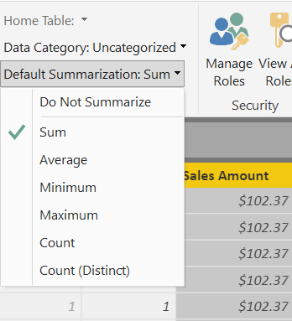
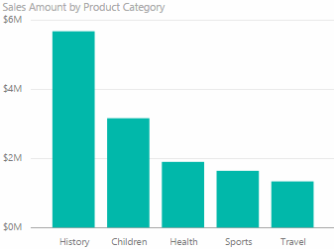
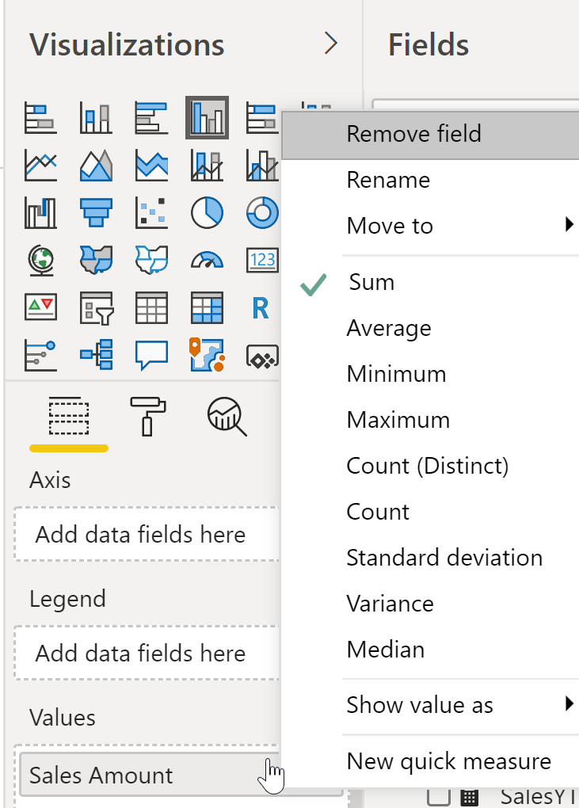
What is a Default Summarization?
Default Summarization
On the Modeling ribbon
For an individual visualization
Sales Amount is automatically summed for each category
You should set this summarization for all numeric fields in the Modeling ribbon
© 2020 Microsoft. All rights reserved.
Notes:
DEMO: Show Default Summarization tab
Instructor Note:
Ask the participants why it works (ie. How does it know to Sum?).
When you drop a calculated column into the visual, Power BI creates Implicit Measure (using Default Summarization). In this case, the implicit measure is Sum of Calc COGS.
Bring in Sales Amount column from the Sales Fact Table into the value section of the graph on the top left hand side.
Instructor Note:
Creates Implicit Measure – Default Summarizations – we can change it.
Dropping a Text column into the Values – will create a count.
Revert this to a Sum on the sales amount at the end of the demo. We will be using the Sales Amount again and we want to make sure it is a Sum.

Slide 65
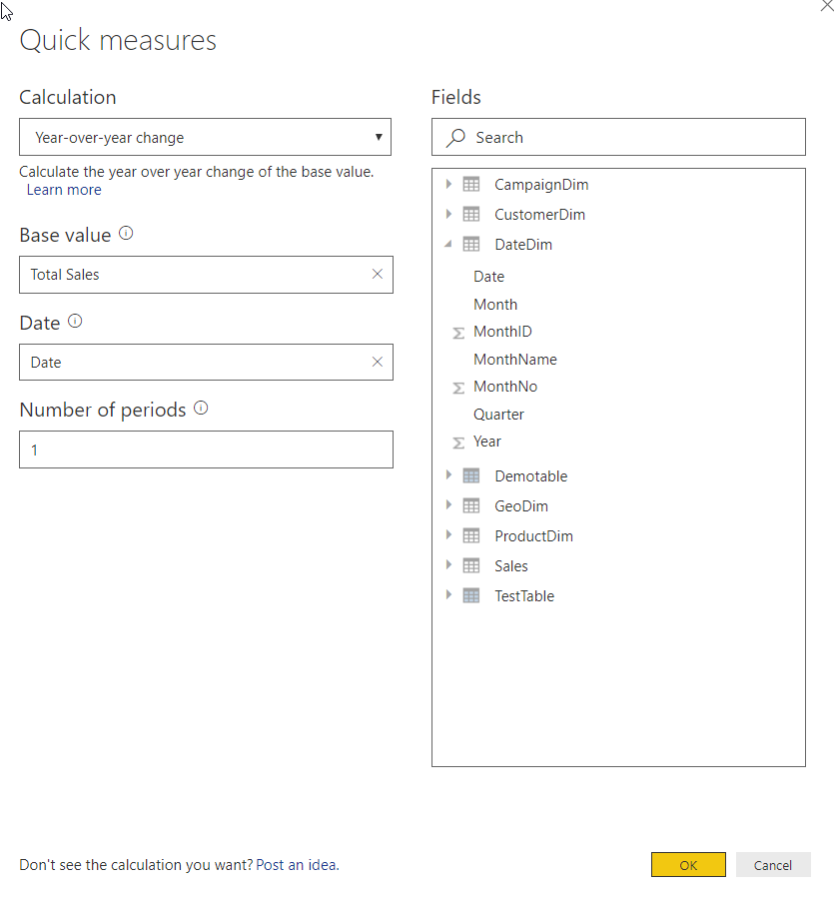
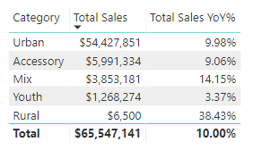
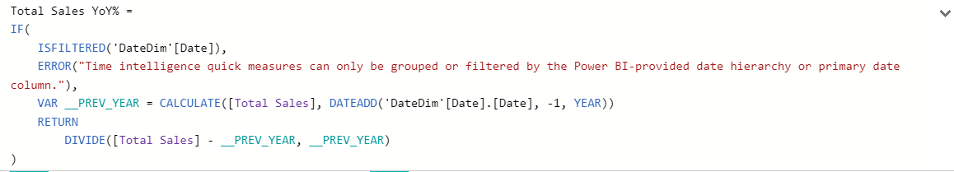
Quick Measures are wizard driven DAX calculations
Quick Measures
Right+Click a table and select Quick Measures
Select calculation type and fill-in parameters
DAX is generated automatically
Great way to learn DAX
See Quick Measure gallery: https://community.powerbi.com/t5/Quick-Measures-Gallery/bd-p/QuickMeasuresGallery
© 2020 Microsoft. All rights reserved.
Notes:
DEMO: Create a Quick Measure in the data model
Note that the DAX has error handling, and my be more complex than the user would write themselves.

Slide 66
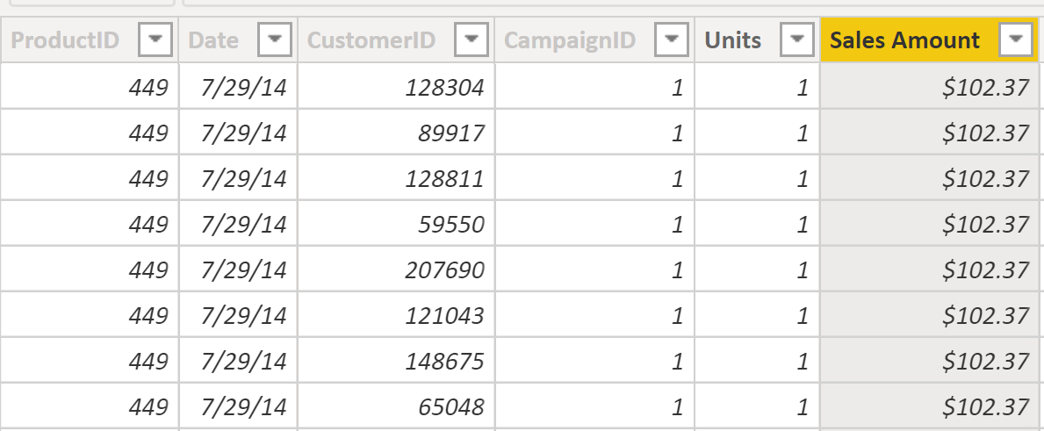
What is a Measure?
Measures
[Total Sales]=SUM(Sales[Sales Amount])
Measures are created using DAX
Place your Measures on a Fact table for best results
Pro Tip: When referring to a measure in other calculations, refer to it without a Table name: [MeasureName]
© 2020 Microsoft. All rights reserved.
Notes:
DEMO:
From the Modeling Ribbon, show measure called Total Sales and that resolves to the same values as default summarization.
Formula: Total Sales = SUM(Sales[Sales Amount])
In the Measure tab, drop the Total Sales measure onto the graph on the right in the values section
Instructor Talking Points:
Explain the calculations in DAX vs Power BI:
On the graph on the top left, the calculations are done by Power BI implicitly.
The graph on the right, show the calculations on the right in DAX which are written, explicitly.
Instructor Note:
Talk about Home Tables. Even though it looks like Measures are in a Fact Table internally they are stored in a separate table called Measures Table
Always ensure the Home Table is a FACT table
Be sure the mention that measures should only be associated with FACT tables, and that measure names must be globally unique within the data model.
If class is interested, may be worth mentioning that the reason measure names must be unique is that they end up being associated with a hidden measures-only table that gets created in the data model

Slide 67
Measure, Use Case 1: Using One Measure in Another
Measures
Instead of writing this:
[Profit] = SUM(Sales[Sales Amount])-SUM(Sales[COGS])
Write this:
[Profit] = [Total Sales]- [Total COGS]
Allows re-use of measures
Formulas are much simpler to read
© 2020 Microsoft. All rights reserved.
Notes:
Advantage to writing DAX
Simplify DAX by referencing other Measures
Quickly reference the list of measures from the formula bar by typing “[“ – As all Measures start with this character

Slide 68
Measure, Use Case 2: More Complex Calculations
Measures
[Profit Margin %] = [Profit] / [Total Sales]
Ratios are calculations that cannot be created using a Calculated Column or Default Summarization
Use DAX DIVIDE for built in error handling
[Profit Margin %] = DIVIDE([Profit] , [Total Sales])
© 2020 Microsoft. All rights reserved.
Notes:
DEMO:
Profit Margin = Sales[Sales Amount] – Sales[Cogs]
Profit Margin % = DIVIDE([Profit Margin], Sum(Sales[COGS]) )

Slide 69
Measure, Use Case 3: More Complex Calculations Using Variables
Measures
MobileSalesLastYear =
VAR MobileProducts = FILTER(
ALL('CampaignDim'[Device]),
CampaignDim[Device]="Mobile"
)
VAR LastYear = SAMEPERIODLASTYEAR('DateDim'[Date])
RETURN
CALCULATE(SUM(Sales[Sales Amount]),MobileProducts,LastYear)
Allows re-use of variables
Formulas are much simpler to read
© 2020 Microsoft. All rights reserved.
Notes:
DEMO:
Measure uses functions like ALL and SAMEPERIODLASTYEAR. These functions will be discussed in detail shortly.

Slide 70
When is a Measure Evaluated?
DAX Foundations
“Get Data” Phase
Model Creation Phase
Model
Enhancement
Phase
Visual
Building Phase
Create Query in “M”
Compress data
auto detect relationships
Add calc. columns, Measures
Add missing relationships
Evaluate Measures and build each visual
© 2020 Microsoft. All rights reserved.

Slide 71
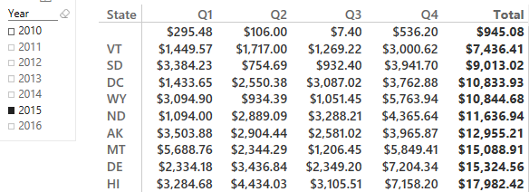
Calculated Column vs. Measure - When to Use What
Calculated Column vs Measure
Columns
Values
Slicer
Rows
Rule of Thumb for Calculated Column vs Measure
Calculated Column – Use in Page, Report & Visual Filters as well as Slicers, Rows and Columns
Measures - Use in Values section
© 2020 Microsoft. All rights reserved.
Notes:
Values use either an implicit Measure or Explicit Measure (explicitly written DAX)

Slide 72
Lab 02
Notes:
Just because you can doesn’t mean you should add a calculated column to the fact table.
Insure the instructors know to create a table with the new field and measure, then show that you can create the same visual by dragging the two "related" fields into the a table with the units. Same visual, no expensive calculated column
Expected results:
1. Total Units Sold = SUM(Sales[Units])
2. Category, Campaign = RELATED(ProductDim[Category]) & ", " & RELATED(CampaignDim[TrafficChannel])
3. Create a table (or column chart, or whatever) and compare the explicit measure that was just created with the implicit measure from pulling in Units. Talk about how you might go about verifying a more complex measure.

Slide 73
Lab 02
Open the files:
Data Modeling Labs Student Modeling Pre-class.pbix
Complete the 1st Lab 02 – Create new measures and columns
© 2020 Microsoft. All rights reserved.
Notes:
What happens when you drop a Calculated column in a Values section – DAX implicitly calculates a measure on top of it. It is a bad thing because you did not tell DAX what to do and DAX just assumed that you wanted to do something with it.
Ex. Drop Profit in Sales

Slide 74
KNOWLEDGE CHECK Module 3
When is Calculated Column Evaluated?
What is Default Summarization?
When is a Measure Evaluated?
When to use Measures and Calculated Columns?
© 2020 Microsoft. All rights reserved.
Notes:
What happens when you drop a Calculated column in a Values section – DAX implicitly calculates a measure on top of it. It is a bad thing because you did not tell DAX what to do and DAX just assumed that you wanted to do something with it.
Ex. Drop Profit in Sales

Slide 75
Power BI Data Modeling in a Day
Module 4
CALCULATE

Slide 76
KNOWLEDGE CHECK ANSWERS Module 4
What are the basic functions of the CALCULATE statement
Filter context and row context
© 2020 Microsoft. All rights reserved.

Slide 77
PATH to DAX Expertise
DAX Foundations
Evaluation Contexts
CALCULATE
Calculated Columns and Measures
© 2020 Microsoft. All rights reserved.
Notes:
Evaluation Context – Single biggest reason that people give up on DAX
Want to Simplify the Evaluation Context

Slide 78
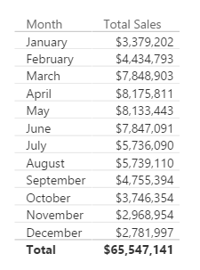
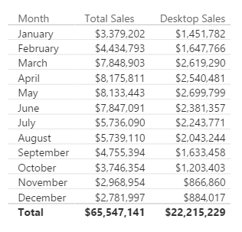
Why is CALCULATE Useful?
CALCULATE
You create a report of breakdown of Sales by Month
Typical Business Question:
Provide a breakout of this Sales from Desktop
© 2020 Microsoft. All rights reserved.
Notes:
In Excel, there are SUMIF and SUMIFS functions – Calculate give you that flexibility and much more as it can be used with ANY Aggregation/Calculation
MYR – Drill to one Department’s data – and change the shape and it will all still work

Slide 79
Here is how you do it with CALCULATE
CALCULATE
[Desktop Sales] = CALCULATE([Total Sales], CampaignDim[Device] = "Desktop")
Use CALCULATE function to create a Measure which filters down to Desktop Sales
© 2020 Microsoft. All rights reserved.
Notes:
Note that even if you apply a “Device” Slicer to this page, the measure [Desktop Sales] will always show Desktop

Slide 80
Anatomy of CALCULATE
CALCULATE
CALCULATE(Expression, [Filter 1], [Filter 2]…..)
Filter Arguments
EXPRESSION used as the first parameter is essentially the same as a measure
CALCULATE works differently from other DAX functions
The second set of arguments, i.e. the “Filter arguments,” are evaluated and applied first
Then the Expression is evaluated under new “Filter Context"
© 2020 Microsoft. All rights reserved.
Notes:
ALL Filters arguments are ANDs – FILTERS ARE CALCULATED FIRST (to filter the rows), then the math is applied

Slide 81
CALCULATE – The Most Important Function in DAX
CALCULATE – Add Filter
4 Key functions that CALCULATE can do:
Add Filter
Ignore Filter
Update Filter
Convert Row Context to Filter Context
© 2020 Microsoft. All rights reserved.
Notes:
Transition slide

Slide 82
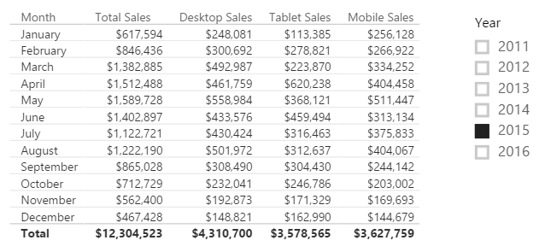
CALCULATE – Add Filter
[Desktop Sales] = CALCULATE([Total Sales], CampaignDim[Device] = "Desktop")
[Tablet Sales] = CALCULATE([Total Sales], CampaignDim[Device] = “Tablet")
[Mobile Sales] = CALCULATE([Total Sales], CampaignDim[Device] = “Mobile")
*When the Device Slicer is selected, only “Total Sales” changes.
© 2020 Microsoft. All rights reserved.
Notes:
Demo: Table from “Calculate-Add” report
Note the effect that the Year Slicer has on the table (All items change)
When the Device Slicer is selected, only “Total Sales” changes.
Filter Context : Jan + 2015
Jan + 2015 + Desktop
Jan + 2015 + Tablet

Slide 83
CALCULATE – The Most Important Function in DAX
CALCULATE – Ignore Filter
4 Key functions that CALCULATE can do
Add Filter
Ignore Filter
Update Filter
Convert Row Context to Filter Context
© 2020 Microsoft. All rights reserved.

Slide 84
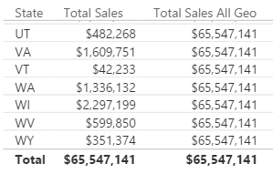
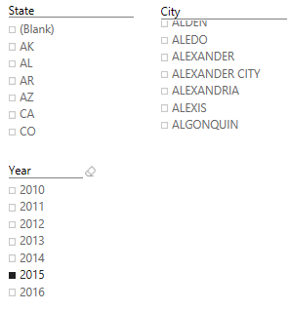
CALCULATE – Ignore an existing filter
[Total Sales All Geo] = CALCULATE([Total Sales], ALL(GeographyDim))
*Ignore filter on ANY column from the GeographyDim table, but allows filters from Year
© 2020 Microsoft. All rights reserved.
Notes:
Optionally you can talk about the next three slides and then go into a demo to show all 3 in action instead of demoing each individually.
DEMO “Calculate- Ignore” Tab:
The table visualization, with each slide, expose the related column
Expose measure called [Total Sales All Geo] – Ignore filter on ANY column from the GeographyDim table, but allows filters from Year
Discuss that this measure can be used to calculate a % of Total measure

Slide 85
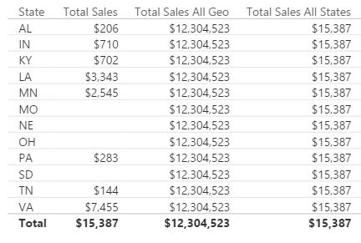
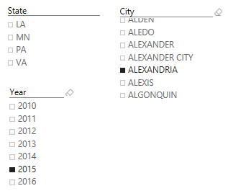
CALCULATE – Ignore an existing filter
[Total Sales All States] = CALCULATE([Total Sales], ALL(GeographyDim[State]))
*Ignore filter on the STATE column from the GeographyDim table, but allows filters from Year
© 2020 Microsoft. All rights reserved.
Notes:
DEMO “Calculate- Ignore” Tab:
The table visualization, with each slide, expose the related column
Expose measure called [Total Sales All State] – Ignore filter on the STATE column from the GeographyDim table, but allows filters from Year
Slice on City (Aberdeen is good)

Slide 86
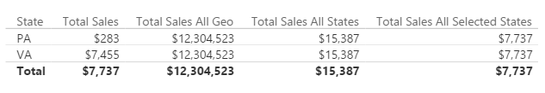
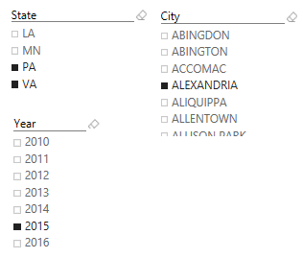
CALCULATE – Ignore an existing filter
[Total Sales All Selected States] = CALCULATE([Total Sales], ALLSELECTED(GeographyDim[State]))
*Ignore filter on the STATE column from the GeographyDim table, but allows filters from Year
© 2020 Microsoft. All rights reserved.
Notes:
DEMO “Calculate- Ignore” Tab:
The table visualization, with each slide, expose the related column
Expose measure called [Total Sales All Selected State] – Ignore filter on the STATE column from the GeographyDim table, but allows filters from Year
Slice on City (Aberdeen is good), then select multiple State, see that the measure now only displays the total for selected states.

Slide 87
CALCULATE – The Most Important Function in DAX
CALCULATE – Update Filter
4 Key functions that CALCULATE can do
Add Filter
Ignore Filter
Update Filter
Convert Row Context to Filter Context
© 2020 Microsoft. All rights reserved.

Slide 88
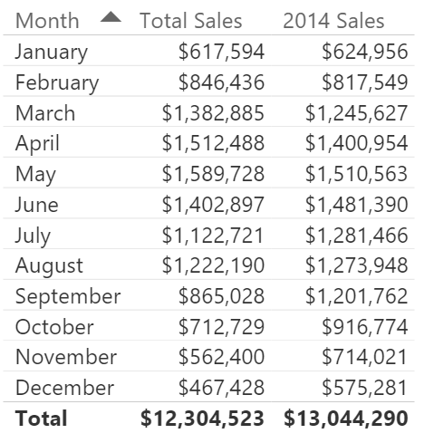
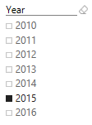
CALCULATE – Update Existing Filter
[2014 Sales] = CALCULATE([Total Sales], DateDim[Year] = 2014)
*Ignores filter on the Year Slicer
© 2020 Microsoft. All rights reserved.
Notes:
DEMO “Calculate- Update” Tab:
The measure called [2014 Sales] – Ignores filter on the Year Slicer.

Slide 89
CALCULATE – The Most Important Function in DAX
CALCULATE – Convert Row Context to Filter Context
4 Key functions that CALCULATE can do
Add Filter
Ignore Filter
Update Filter
Convert Row Context to Filter Context
Let’s investigate what we mean by Filter Context
© 2020 Microsoft. All rights reserved.
Notes:
Transition to Evaluation Contexts: Row & Filter

Slide 90
Power BI Data Modeling in a Day
Module 5
DAX Evaluation Contexts

Slide 91
MODULE 5 OBJECTIVES
Understand that there are different kinds of evaluation contexts and be able to explain what different contexts are in play
Be able to use iterator functions and CALCULATE to create sophisticated measures
© 2020 Microsoft. All rights reserved.

Slide 92
PATH to DAX Expertise
DAX Foundations
Evaluation Contexts
CALCULATE
Calculated Columns and Measures
© 2020 Microsoft. All rights reserved.

Slide 93
DAX Function Types
Scalar Functions
Table Functions
Scalar functions return a Single value as an output
Ex. SUM(Sale[Sales Amount])
Table functions return a Table as an output
Ex. ALL(GeographyDim)
There are other ways to classify functions – By kind of operation they perform etc.
© 2020 Microsoft. All rights reserved.
Notes:
Scalar is a fancy word for using a single coordinate in the evaluation
What if you want bring in a Table or List of values and apply your calculation to them?

Slide 94
Evaluation Context
There are two contexts under which calculations are evaluated
Row Context
Filter Context
© 2020 Microsoft. All rights reserved.
Notes:
Two gods you can invoke in your DAX calculation
Can be blended in a single calculations

Slide 95
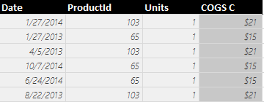
Row Context in Calculated Column
Sales[COGS] = RELATED(ProductDim[Unit Cost]) * Sales[Units]
Formula is evaluated row by row
The context under which formula is evaluated for each row is called “Row Context”
Pro Tip: To accumulate up from Fact to Dimension, use RELATEDTABLE()
© 2020 Microsoft. All rights reserved.
Notes:
Row context invoked when you refer to a column in a calculated column formula without an aggregation function surrounding it
Row Context – How many units sold in Row 1?

Slide 96
Evaluation Context
Both Calculated Columns and Measures are always evaluated under two contexts
Row Context
Filter Context
© 2020 Microsoft. All rights reserved.
Notes:
Filter Context is defined by the Visual

Slide 97
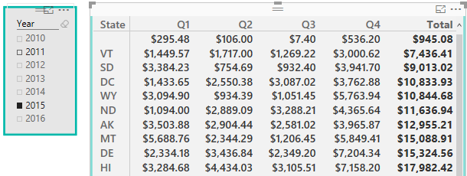
Filter Contexts in Measures
Filter Context in a Measure – Example 1
[Total Sales] = SUM(Sales[Sales Amount])
Filter Context for current coordinate
Formula is evaluated for each “Coordinate” in each visual
The context for each coordinate is called “Filter Context”
© 2020 Microsoft. All rights reserved.
Notes:
Discuss the filter context for the selected cell
Think in terms of co-ordinates (lat/longitude)

Slide 98
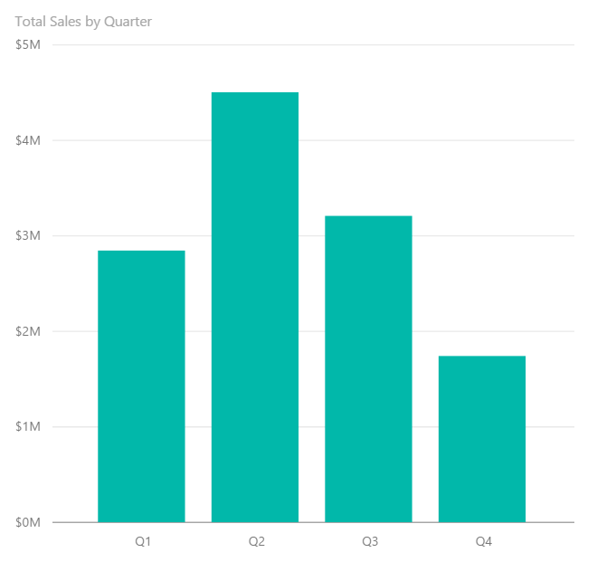
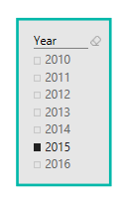
Filter Context in a Measure – Example 2
Filter Contexts in Measures
[Total Sales] = SUM(Sales[Sales Amount])
Filter Context : Year = 2015, Quarter = Q1
Filter Context : Year = 2015, Quarter = Q2
© 2020 Microsoft. All rights reserved.
Notes:
Charts and Graphs also have Filter Context. EACH data point has a unique Filter Context

Slide 99
Filter Context in a Measure
Filter Contexts in Measures
[Total Sales] = SUM(Sales[Sales Amount])
Better definition of above measure:
“Total Sales” – SUM of Sales[Sales Amount] column under a filter context
© 2020 Microsoft. All rights reserved.
Notes:
A measure is not evaluated until it is in a Visual – and will be under a filter context

Slide 100


Filter Context and Multiple Tables
Filter context automatically propagates from Dim Table to Fact Table
Filtering the DateDim Table to Year = 2015 returns only Sales for 2015
© 2020 Microsoft. All rights reserved.
Notes:
In a Uni-Directional relationship, the filter can only flow from the Dim to the Fact
In a BI-Directional relationship, the filter can flow each way.

Slide 101

Filter Context and Multiple Tables
Filter Context and Multiple Tables
Filters (Filter context) automatically propagate based on direction of arrows in relationships
Examples
Filter goes from DateDim to CustomerDim
Filter does not go from CustomerDim to DateDim
© 2020 Microsoft. All rights reserved.
Notes:
In a Uni-Directional relationship, the filter can only flow from the Dim to the Fact
In a BI-Directional relationship, the filter can flow each way.

Slide 102

Filter Context and Multiple Tables – Right Arrow Direction
Filter Context and Multiple Tables
Cross filtering works properly
Filter goes from DateDim to CustomerDim
This is why the above Pivot table works
© 2020 Microsoft. All rights reserved.
Notes:
Show going to the data model and updating the relationship from Single to Both (or back)
Toggle between this and the next slide
Why can’t I just enable all bi-directional relationships
They are expensive
Only turn them from Uni- to Bi- when absolutely necessary

Slide 103

Filter Context and Multiple Tables – Wrong Arrow Direction
Filter Context and Multiple Tables
Cross filtering does not work
Filter goes from DateDim to CustomerDim
This is why the Count of Month in the table above is incorrect
© 2020 Microsoft. All rights reserved.
Notes:
See Barbara’ Blog on the many to many using key words (also note there is a custom Key Word text filter)

Slide 104
Evaluation Context Multiple Table – Summary and Take Aways
Evaluation Context and Multiple Tables
Row Context
Filter Context
Does not propagate automatically
Need to use
RELATED
RELATEDTABLE
Propagates automatically
Depends on direction of arrow in relationship diagram
© 2020 Microsoft. All rights reserved.

Slide 105
Applications of Table Functions
Table functions can be used 2 ways in Power BI Desktop
As an input to another DAX function
CALCULATE
Iterator functions
Calculated Tables
© 2020 Microsoft. All rights reserved.
Notes:
Demo CALCULATED Table example in Power BI Desktop model
Call out the fact that CALCULATED Tables are just like a calculated column – Calculated during processing time or refresh time
You can use this table just like any other DAX in the model – You can create relationships etc.
Go to the Desktop and create a new Demo Table = ALL(GeographyDim) – duplicate with a separate memory footprint.

Slide 106
Basic TABLE Functions
Return All Rows
Return Distinct Rows
Return Filtered Rows
ALL & variants
ALL, DISTINCT, VALUES
FILTER
There are more advanced Table functions, which we will not cover
© 2020 Microsoft. All rights reserved.
Notes:
We will discuss three classes of Table function
No demo yet.

Slide 107
Basic TABLE Functions – Return All Rows
The ALL function - Can take either Table or Columns in a Table as input
ALL with Entire Table
ALL with One Column
ALL with Multiple Columns
ALL(GeographyDim)
ALL(GeographyDim[Region]))
ALL(GeographyDim[Region],
GeographyDim[State])
Returns all rows all columns in Table
Returns all unique values of Column
Returns all unique combinations of Column values
© 2020 Microsoft. All rights reserved.
Notes:
No Demo (already shown in previous demos)

Slide 108
Basic TABLE Functions – ALL Versions
There are several forms of the ALL function
ALL
ALLEXCEPT - Return all columns in a Table except 1 or more columns
ALLSELECTED – Return all values in a column selected by users in Slicers
ALLNONBLANKROW – Return all non-Blank rows
© 2020 Microsoft. All rights reserved.
Notes:
We demonstrated these functions in the CALCULATE section
Table1 – has a duplicate row
When I write ALL on the whole table, I get the whole table
When I write ALL on the two columns of the table, it removes duplicates
Blank vs a mismatch
ALLEXCEPT - Overrides all context filters in the table except over the specified columns; useful when you want only one column on a table to be sliceable
ALLSELECTED – just like ALL, but if the column is specifically selected, then it respects the slicer
ALLNONBLANKROW – Just like ALL, but does not return any blank rows

Slide 109
Basic TABLE Functions – Return Distinct Rows
VALUES – Return all distinct values in a column or Table
(including blank rows)
DISTINCT - Return all distinct values in a column or Table
(not including blank rows)
© 2020 Microsoft. All rights reserved.
Notes:
No Demo
If when you write VALUES and get a blank you may have Blank or MisMatch
If you change a VALUES to DISTINCT and you still have blank – then it is a real blank – NOT A MISMATCH
DISTINCT is more expensive as well
Blank vs a mismatch – If your model has Fact rows which do not match with dimensions, this is a mismatch – not a true blank.
HASONEVALUE: eturns TRUE when the context for columnName has been filtered down to one distinct value only. Otherwise is FALSE.

Slide 110
Basic TABLE Functions – Return Distinct Value
HASONEVALUE - Returns TRUE when the context for columnName has been filtered down to one distinct value only. Otherwise is FALSE
Header = IF ( HASONEVALUE ( ProductDim[Price Band] ),
CONCATENATE (“Report Header for Price Band : ",
VALUES ( ProductDim[Price Band] )),
"Overall Report")
SELECTEDVALUE - Returns the value when the context for columnName has been filtered down to one distinct value only. Otherwise returns alternateResult.
Header (SELECTEDVALUE) =
VAR selectedPriceBand =SELECTEDVALUE ( ProductDim[Price Band] )
RETURN
IF ( ISBLANK ( selectedPriceBand ), "Overall Report",
CONCATENATE ( "Report Header for Price Band: ", selectedPriceBand )
)
© 2020 Microsoft. All rights reserved.
Notes:
The function HASONEVALUE Returns TRUE when the context for columnName has been filtered down to one distinct value only. Otherwise is FALSE.
The function SELECTEDVALUE returns the value of the column reference passed as first argument if it is the only value available in the filter context, otherwise it returns blank or the default value passed as second argument
Mostly used in slicer selection. E,g, measure is calculated when only one value is selected in slicer
https://www.sqlbi.com/articles/using-the-selectedvalue-function-in-dax/
HASONEVALUE: eturns TRUE when the context for columnName has been filtered down to one distinct value only. Otherwise is FALSE.
*************
To use when a customer wants to return different value depends on the result for example sum above 2.

Slide 111

Basic TABLE Functions – Return Filtered Set of Rows
FILTER(ALL(GeographyDim[Region], GeographyDim[State]), GeographyDim[Region] = “Central”)
Take all unique combinations of GeographyDim[Region], GeographyDim[State]
Filter down to the rows where GeographyDim[Region] = “Central”
© 2020 Microsoft. All rights reserved.
Notes:
The Region = “Central” is in a ROW Context as it is not surrounded by aggregate function
******************
The region filter that should be created takes all the condition and applies calculate expression

Slide 112
DAX Iterator Functions Take Advantage of Evaluation Context
DAX Iterator Functions
Iterator Functions
Creates a row context by iterating over a table that you specify
Ex. SUMX
© 2020 Microsoft. All rights reserved.
Notes:
The table could be calculated ALL(DimGeography[State]) or a table in the data model DimGeography

Slide 113
Table Functions Application - Iterators
[COGS] = SUMX(Sales, Sales[Units] * RELATED(ProductDim[Unit Cost]))
Argument 1
Argument 2
© 2020 Microsoft. All rights reserved.
Notes:
An iterator function takes two arguments – we will walk through this example over the next couple of slides

Slide 114

Table Functions Application - Iterators
[COGS] = SUMX(Sales, Sales[Units] * RELATED(ProductDim[Unit Cost]))
Argument 1
Iterate through each row in Argument 1
Sales
© 2020 Microsoft. All rights reserved.
Notes:
Like a virtual calculated column, but don’t need to perpetually keep the column.
Argument 1 – iterate thru each of the columns in the table argument
****************************************
Gets the value of the unit cost in the table has to do the multiplication for each row
It gets the value of cogs essentially
Calculated column needs space, this why create the SUMX instead

Slide 115


Table Functions Application - Iterators
[COGS] = SUMX(Sales, Sales[Units] * RELATED(ProductDim[Unit Cost]))
Argument 2
Sales
ProductDim
© 2020 Microsoft. All rights reserved.
Notes:
Perform the calculation for each row in the table argument

Slide 116

Row Context in a Measure – Iterator Functions
[COGS] = SUMX(Sales, Sales[Units] * RELATED(ProductDim[Unit Cost]))
SUM it up
SUM up list obtained
© 2020 Microsoft. All rights reserved.
Notes:
Sum the results of all the rows.
Note: This calculation respects the Filter Context of the visual
This example is effectively SumProduct in Excel
****************
Sum operates on specific column

Slide 117
Why Can an Iterator be a Better Approach then a Calculated Column?
Iterators
You avoid creating a Calculated Column
Let us see the impact of a Calculated Column Called COGS on Data model with 100K rows - What if we have 10 M rows?
Iterators help you avoid several “Intermediate Calculated Columns”
© 2020 Microsoft. All rights reserved.
Notes:
DEMO: In your working copy of “Student Modeling Pre-class.pbix” where you have the calculated column [COGS] –
* Save the file and note the size for the class
* Remove the [COGS] calculated Column and re-save the file.
* Note that the file size is about 8% smaller. While file size is not an exact measure of memory use, it is a proxy that most students understand.

Slide 118
CALCULATE – Converting Row Context to Filter Context (Example 1)
DAX Foundations
Sales velocity Segment = IF(
SUMX(RELATEDTABLE(Sales), Sales[Sales Amount])>=200000,
“High Velocity”,
“Low Velocity”)
Sales Velocity (Using CALCULATE) = IF (
CALCULATE(SUM(Sales[Sales Amount])) >= 200000,
"High Velocity",
"Low Velocity")
Another way to do Dynamic Segmentation
This method does not use Iterators
Instead it uses CALCULATE to convert Row Context to Filter Context
© 2020 Microsoft. All rights reserved.
Notes:
Walk through demo:
Go to ProductDimTable
Create a column = SUM(Sales[Sales Amount]) – This will show total sales for the entire data model not taking the row context into account.
Show the first Calculated Column, the SUMX and RELATEDTABLE functions transfer row context to filter context.
In the second formula wrapping the SUM in a CALCULATE does the same thing.

Slide 119
Other Iterator Functions
AVERAGEX , PRODUCTX, MINX, MAXX– All work the same way as SUMX
RANKX – Works similar to SUMX, but slightly more complex (more options)
© 2020 Microsoft. All rights reserved.

Slide 120
Table Functions – Summary and Application
Table functions can be used in 2 ways in Power BI Desktop:
As an input to another DAX function
CALCULATE
Iterator functions
Calculated Tables
CALCULATE is one of the primary places where Table functions are used
© 2020 Microsoft. All rights reserved.

Slide 121
Lab 03
Open the files:
Data Modeling Labs Student Modeling Pre-class.pbix
Complete Lab 03 – Create Report for the VP
© 2020 Microsoft. All rights reserved.
Notes:
For advanced users who have completed the lab during the time remaining:
What happens when you drop a Calculated column in a Values section – DAX implicitly calculates a measure on top of it. It is a bad thing because you did not tell DAX what to do and DAX just assumed that you wanted to do something with it.
Ex. Drop Profit in Sales

Slide 122
KNOWLEDGE CHECK Module 5
What are the different kinds of evaluation contexts?
When are filter or a row contexts present?
Which functions are commonly used to modify existing evaluation contexts?
© 2020 Microsoft. All rights reserved.

Slide 123
Power BI Data Modeling in a Day
Module 6
Advanced DAX
Time Intelligence Functions

Slide 124
MODULE 6 OBJECTIVES
Be able to parse advanced DAX formulas (e.g., cumulative functions)
Gain familiarity with standard DAX patterns
Introduction to resources for further learning
© 2020 Microsoft. All rights reserved.

Slide 125

Before we get to Time Intelligence - Let us apply all of the DAX techniques
Advanced DAX
[SalesYTD] =
CALCULATE (
[Total Sales],
FILTER (
ALL ( DateDim),
DateDim[Year] = MAX ( DateDim[Year] )
&& DateDim[Date] <= MAX(DateDim[Date])
)
)
Let us take a super complicated DAX statement and break it down and understand what it means
© 2020 Microsoft. All rights reserved.
Notes:
Tab: Time Intelligence-YTD
Slides walk thru the logic – Follow the narrative of the next 5 slides

Slide 126
Before we get to Time Intelligence - Let us apply all of the DAX techniques
Advanced DAX
[SalesYTD] =
CALCULATE (
[Total Sales],
FILTER (
ALL ( DateDim),
DateDim[Year] = MAX ( DateDim[Year] )
&& DateDim[Date] <= MAX( DateDim[Date] )
)
)
In a CALCULATE statement Filter arguments are evaluated first
The Filter in this case comes from a FILTER function
FILTER function is an iterator
© 2020 Microsoft. All rights reserved.

Slide 127
Let us apply all of the data modeling techniques
Advanced DAX
[SalesYTD] =
CALCULATE (
[Total Sales],
FILTER (
ALL ( DateDim),
DateDim[Year] = MAX ( DateDim[Year] )
&& DateDim[Date] <= MAX( DateDim[Date] )
)
)
In a FILTER statement the input Table is evaluated first
ALL statement means take all DateDim
© 2020 Microsoft. All rights reserved.

Slide 128
Let us apply all of the data modeling techniques
Advanced DAX
[SalesYTD] =
CALCULATE (
[Total Sales],
FILTER (
ALL ( DateDim),
DateDim[Year] = MAX ( DateDim[Year] )
&& DateDim[Date] <= MAX(DateDim[Date] )
)
)
Iterate through each row in DateDim
Check for condition based on row context and filter context
Pro Tip: if you need to concatenate two conditions with an AND use && for and OR use ||
© 2020 Microsoft. All rights reserved.
Pro Tip: if you need to concatenate two conditions with an AND use && for and OR use ||

Slide 129
Let us apply all of data modeling techniques
Advanced DAX
[SalesYTD] =
CALCULATE (
[Total Sales],
FILTER (
ALL ( DateDim),
DateDim[Year] = MAX ( DateDim[Year] )
&& DateDim[Date] <= MAX(DateDim[Date] )
)
)
Now you have a FILTERED list of dates
Use this to update the filter context (since it is in a CALCULATE statement)
© 2020 Microsoft. All rights reserved.

Slide 130
Let us apply all of the data modeling techniques
Advanced DAX
[SalesYTD] =
CALCULATE (
[Total Sales],
FILTER (
ALL ( DateDim),
DateDim[Year] = MAX ( DateDim[Year] )
&& DateDim[Date] <= MAX(DateDim[Date] )
)
)
Use updated FILTER context to evaluate ‘Total Sales’
© 2020 Microsoft. All rights reserved.

Slide 131
Introducing Time Intelligence – There is an App for that!!
Advanced DAX – Time Intelligence
[SalesYTD Easier] =
CALCULATE (
[Total Sales],
DATESYTD(DateDim[Date])
)
This allows you to write the formula without being a DAX guru!
Microsoft is continuously improving Time Intelligence functions to make it simple to use
Time Intelligence functions are your friends – They will save you time!
© 2020 Microsoft. All rights reserved.
Notes:
****************
Which has the better result? Given the option use calculate, same results and performance

Slide 132
Advanced DAX – Month over Month
Total Sales Last Month =
CALCULATE([Total Sales],
PREVIOUSMONTH(DateDim[Date]))
MoM =
DIVIDE([Total Sales] - [Total Sales Last Month],
[Total Sales Last Month])
DAX has several shortcut Time Intelligence functions
© 2020 Microsoft. All rights reserved.
Notes:
Additional calculations to discuss commonly used scenarios
Calculates based on same day in prior month
MoM – Month over Month
*****************
Best practice – if there is division use Divide

Slide 133
Advanced DAX – Monthly Active Users
[Monthly Active Users] =
CALCULATE(
SUMX(VALUES(Sales [CustomerId]),1),
ALL('DateDim'),
DATESINPERIOD('DateDim'[Date],
LASTDATE('DateDim'[Date]), -1, MONTH)
)
Sumx vs DistinctCount of CustomerID
SUMX can be more performant
© 2020 Microsoft. All rights reserved.
Notes:
Another commonly used scenario
Calculates based on same day in prior month – Discuss usage of DATESINPERIOD and LASTDATE
***************
Add more steps to calculate and how it adds up to this result

Slide 134
Other Time Intelligence Functions
Advanced DAX – Time Intelligence
DATESINPERIOD
DATESYTD
DATESQTD
NEXTMONTH NEXTYEAR
Pro Tip: Learn about Time Intelligence functions - https://msdn.microsoft.com/en-us/library/ee634763.aspx
© 2020 Microsoft. All rights reserved.

Slide 135
KNOWLEDGE CHECK Module 6
Can I parse advanced DAX formulas?
What are some standard DAX patterns?
Which time intelligence functions are built-in to DAX?
© 2020 Microsoft. All rights reserved.

Slide 136
Power BI Data Modeling in a Day
Module 7
DAX Best Practices

Slide 137
MODULE 7 OBJECTIVES
Emphasize importance of writing efficient DAX measures
© 2020 Microsoft. All rights reserved.

Slide 138
Use Variables instead of Repeating Measures
Consider the following DAX expression:
Ratio = IF([Total Rows] > 10, SUM(Revenue) /[Total Rows], 0)
Faster DAX:
VAR totalRows = [Total Rows];
Ratio = IF(totalRows > 10, SUM(Revenue) / totalRows,0)
In the first expression, since measures are calculated on the fly, the [Total Rows] expression gets calculated twice, first for the condition check and then for the true condition expression
Instead of calculating the same expression multiple times, the resulting measure value can be stored in a variable and variable reference can be used wherever required
© 2020 Microsoft. All rights reserved.
Notes:
By using a variable, you can get the same outcome, but in a more readable way. In addition, the result of the expression is stored in the variable upon declaration. It doesn’t have to be recalculated each time it is used, as it would without using a variable. This can improve the measure’s performance.
https://docs.microsoft.com/en-us/dax/var-dax

Slide 139
Use DIVIDE() Instead of /
DIVIDE() function has 3rd extra parameter which is returned in case of denominator being zero
It internally performs check to validate if the denominator is 0
There is no need to use IF condition along with '/' operator to check for invalid denominator
DIVIDE() also checks for ISBLANK()
Note: If it is certain that the denominator value would not be 0, then it is better to use '/' operator without any IF check since DIVIDE() function would always perform an IF check internally
© 2020 Microsoft. All rights reserved.
Notes:
Emphasizing what is covered in Slide 66

Slide 140
Calculate Ratios Efficiently
Use (a-b)/b with variables instead of a/b – 1 or a/b*100 – 100
We can achieve the same performance by using variables and using (a-b)/b to calculate ratio
If both a and b are blank values, then (a-b)/b would return blank and would be filtered out where as a/b – 1 would return -1 and increase query space
© 2020 Microsoft. All rights reserved.
Notes:
As covered in Slide 133, 134 and 135 this is a combination of using variables, using DIVIDE function and creating efficient measures where blanks are filtered out improving query efficiency

Slide 141
Don’t change blanks to zeros or other values
Sometimes people replace blanks with zeros or other strings
Power BI automatically filters out all the rows with blank values from query results
If the blanks are replaced, the query space is greatly increased
© 2020 Microsoft. All rights reserved.
Notes:
Typically data modelers convert blanks to zeros:
While loading data in Power Query
In Measures to display 0 instead of blanks slowing down the measure

Slide 142
Use SELECTEDVALUE() instead of HASONEVALUE()
A common pattern is to use HASONEVALUE() to check if there is only one value present for a column after applying slicers and filters and then use VALUES(ColumnName) DAX function to get the single value
SELECTEDVALUE() performs both the above steps internally and gets the value if there is only one distinct value present for that column or returns blank in case there are multiple values available
© 2020 Microsoft. All rights reserved.
Notes:
SELECTEDVALUE AND HASONEVALUE is discussed in slide 107
The function SELECTEDVALUE returns the value of the column reference passed as first argument if it is the only value available in the filter context, otherwise it returns blank or the default value passed as second argument
Mostly used in slicer selection. E,g, measure is calculated when only one value is selected in slicer
https://www.sqlbi.com/articles/using-the-selectedvalue-function-in-dax/

Slide 143
Use SELECTEDVALUES() instead of VALUES()
VALUES() returns error in case it encounters multiple values. Normally, users handle it using Error functions which are bad for performance
Instead of using that, SELECTEDVALUE() must be used which is a safer function and returns blank in case of multiple values being encountered
© 2020 Microsoft. All rights reserved.
Notes:
This is a follow up to slide 139.
Typically HASONEVALUE and VALUES are used together. Instead you can use SELECTEDVALUE

Slide 144
Use DISTINCT() and VALUES() functions consistently
Power BI adds a Blank value to the column in case it finds referential integrity violation
For direct query, Power BI by default adds blank value to the columns as it does not have a way to check for violations
Difference :
DISTINCT(): Does not return blank which is added due to integrity violation. It includes blank only if it is part of original data
VALUES(): It includes blank which is added by Power BI due to referential integrity violation
The usage of either of the function should be same throughout the whole report
Power BI recommends to use VALUES() in the whole report if possible and blank value is not an issue
© 2020 Microsoft. All rights reserved.
Notes:
Blank() is covered in Slide 106
Values() is covered in Slide 107
https://www.sqlbi.com/blog/marco/2011/03/08/difference-between-distinct-and-values-in-dax/

Slide 145
Avoid using IFERROR() and ISERROR()
IFERROR() and ISERROR() are sometimes used in measures
These functions force Power BI engine to perform step by step execution of each row to check for errors as there is currently no way which directly states which row returned the error
FIND() and SEARCH() DAX functions provide an extra parameter which can be passed and is returned in case of the search string not present – avoids use of IFERROR/ISERROR
Both of this functions are currently also used to check for divide by zero error or along with values to check if more than one values are returned.
Can be avoided by using the correct DAX functions like DIVIDE() and SELECTEDVALUE() which performs the error check internally and returns the expected results
© 2020 Microsoft. All rights reserved.
Notes:
Usage example
Measure= IFERROR([Measure 1] / [Measure 2], 0, [Measure 1] / [Measure 2])
Or in a calculate column:
=IFERROR(SEARCH(“RP*”,DimProduct[Product]),-1)
If DAX measure has multiple steps and there is a check for error. E.g. If there is an error do X else do Y. Logically this is correct but slows down the measure

Slide 146
Use ISBLANK() instead of =BLANK() check
Use inbuilt function ISBLANK() to check for any blank values instead of using comparison operator “= Blank()”
ISBLANK() is faster
© 2020 Microsoft. All rights reserved.
Notes:
https://xxlbi.com/blog/different-blanks-in-dax/
https://www.sqlbi.com/articles/blank-handling-in-dax/

Slide 147
Use FILTER(ALL(ColumnName))
To calculate measures ignoring all the filters applied on a column, use All(ColumnName) function along with the FILTER instead of Table or VALUES(). Eg: CALCULATE([Total Sales], FILTER(ALL(Products[Color]), Color = 'Red’))
Directly applying filters using expressions and not using FILTER function behaves in the same way as mentioned above and it internally translates to use ALL function in the filter
Eg: CALCULATE([Total Sales], Products[Color]= 'Red’)) ->
CALCULATE([Total Sales], FILTER(ALL(Products[Color]), Products[Color]= 'Red’)
It is always better to apply filters at desired column than the whole table
Always use ALL along with FILTER function if there is no specific need to keep current context
https://pbidax.wordpress.com/2016/05/22/simple-filter-in-dax-measures/
https://www.sqlbi.com/articles/filter-arguments-in-calculate/
© 2020 Microsoft. All rights reserved.
Notes:
Refer to Slide 81-83

Slide 148
Do not use scalar variables in SUMMARIZE()
SUMMARIZE() traditionally used to perform grouping of columns and get the resulting aggregations along with it
It is recommended to use SUMMARIZECOLUMNS() function which is a newer more optimized version
SUMMARIZE function should only be used to get just the grouped elements of a table without any measures/aggregations associated with it.
E.g. SUMMARIZE(Table, Column1, Column2)
© 2020 Microsoft. All rights reserved.
Notes:
https://www.sqlbi.com/blog/marco/2020/02/02/using-summarizecolumns-instead-of-summarize-in-dax-powerbi-ssas-tabular/
https://dax.guide/summarizecolumns/
https://docs.microsoft.com/en-us/dax/summarizecolumns-function-dax
SummarizeExample =
SUMMARIZECOLUMNS (
DateDim[Year],
ProductDim[Price Band],
"Sales Amount", SUMX ( Sales, Sales[Units] * RELATED ( ProductDim[Unit Cost] ) )
)
*********************************
Even when only powerview was available it was using the summarizecolumns. It is more optimized than the Summarize(). This is a great performance improvement.
Look at the new functions that come up and see which performance enhancements needed.

Slide 149
Avoid using ADDCOLUMNS() in member expressions
Measures are calculated in iterative manner by default
If measure definitions use iterative functions like AddColumns, it create nested iteration which downgrades the performance
© 2020 Microsoft. All rights reserved.
Notes:
https://www.sqlbi.com/articles/best-practices-using-summarize-and-addcolumns/

Slide 150
Avoid string manipulation in measures
Slows down measures
Work is done in calculation engine
© 2020 Microsoft. All rights reserved.
Notes:
String manipulation example: To deal with data not in the right format. E.g. Usernames, getting a substring (remove @emailaddress) to use in a measure. This reduces measure performance
We have used string manipulation to create header (SelectedValue page in report). This is ok, because it’s a simple measure. But if you dealing with large volume of data, reduces performance. Be careful where you use it.
*******************
Example of taking a measure value and show if it is increasing or decreasing

Slide 151

Performance Analyzer
Using Performance Analyzer:
You will know how each of your report elements, such as visuals and DAX formulas, are performing
You can see and record logs that measure how each of your report elements performs when users interact with them, and which aspects of their performance are most (or least) resource intensive
© 2020 Microsoft. All rights reserved.
Notes:
https://docs.microsoft.com/en-us/power-bi/desktop-performance-analyzer

Slide 152
KNOWLEDGE CHECK Module 7
Which of these are best practice ?
isBlank() or comparison operation =Blank()
SELECTEDVALUE() or HASONEVALUE()
DIVIDE() or IFERROR()
Using variables or repeating calculations
© 2020 Microsoft. All rights reserved.

Slide 153
Power BI Support Resources
Contact Support - Report Errors, Issues – Support.PowerBI.com
Resources use presentation mode to click the hyperlinks
Community.PowerBI.com – Community Forum
Data Stories Gallery – Get inspired with Data Stories by other Power BI users
R-Visuals Gallery – Get inspired by others use of R for analyzing their data
Visuals.PowerBI.com – Custom PBI visuals and R visuals you can download and use in your story
Power BI Blog - weekly updates
User Voice for Power BI – Vote on (or submit) your favorite new ideas for Power BI
Issues.PowerBI.Com – log issues with the community
Guided Learning Self Service Power BI training DAX Formula Language – syntax for DAX
DAX Patterns – Great website to learn new patterns for the DAX Language
Power Query Formula Language – syntax for the “Query” language
© 2020 Microsoft. All rights reserved.
Notes:
External Support Resources for Microsoft

Slide 154
Thank you! Please fill our survey: https://aka.ms/PBIAdvanced Select: Advanced Data Modeling

Slide 155
Power BI Data Modeling in a Day
QUESTIONS?

Slide 156
Power BI Data Modeling in a Day
APPENDIX

Slide 157
KNOWLEDGE CHECK ANSWERS Module 1
What is a data model in the context of Power BI?
A data model is a collection of tables and relationships
What are some advantages of a star schema over a flat or denormalized model?
Dimension tables save space by reducing the amount of data that needs to be repeated over and over in every row
Relationships between tables can be leveraged for more complex measures
How might you improve the performance of a Power BI model?
Try using a star schema instead of a flat or denormalized model
Remove unnecessary columns
Set appropriate data types
How does Power BI store DateTime information? What are some consequences of this?
DateTime information is stored as a floating-point decimal number. This means that datetimes are very precise but not very efficient to store.
© 2020 Microsoft. All rights reserved.

Slide 158
KNOWLEDGE CHECK ANSWERS Module 2
Which of these help with compression of data and performance?
All of the listed options help with compression of data and performance.
© 2020 Microsoft. All rights reserved.

Slide 159
KNOWLEDGE CHECK ANSWERS Module 3
When is Calculated Column Evaluated?
At the time of data load/data refresh.
What is Default Summarization?
A default summarization is an implicit measure created in the background when you put a numeric field on a visualization. The function used (sum/max/min/avg/…) is based on the numeric field’s default summarization setting.
When is a Measure Evaluated?
At render time.
When to use Measures and Calculated Columns?
It depends ☺. Calculated columns are useful when each row of data should be independently considered (although measures can do this too!) and the result won’t change until the next data refresh. Measures should be used everywhere else.
© 2020 Microsoft. All rights reserved.

Slide 160
MODULE 4 OBJECTIVE
What are the different kinds of evaluation contexts?
Add filter
Ignore filter
Update filter
Convert row context to filter context
How do you add a filter to a CALCULATE statement
Add a hard coded description, Example: Campaign Dim(Device) = “Mobile”
How do you ignore an existing filter in a CALCULATE statement
Use the ALL function
© 2020 Microsoft. All rights reserved.

Slide 161
KNOWLEDGE CHECK ANSWERS Module 5
What are the different kinds of evaluation contexts?
Filter context and row context
When are filter or a row contexts present?
Row contexts are present in iterator functions and calculated column evaluations. Filter contexts are present in pivot tables and other visualizations.
Which functions are commonly used to modify existing evaluation contexts?
CALCULATE, ALL, etc.
© 2020 Microsoft. All rights reserved.

Slide 162
KNOWLEDGE CHECK ANSWERS Module 6
Can I parse advanced DAX formulas?
Yes I can!
What are some standard DAX patterns?
CALCULATE(…)
Which time intelligence functions are built-in to DAX?
Lots of them…YTD, FY, previous month, etc
© 2020 Microsoft. All rights reserved.

Slide 163
KNOWLEDGE CHECK ANSWERS Module 7
Which of these are best practice ?
isBlank() or comparison operation =Blank()
Using isBlank()
SELECTEDVALUE() or HASONEVALUE()
Using SELECTEDVALUE()
DIVIDE() or IFERROR()
Using DIVIDE()
Using variables or repeating calculations
Using variables
© 2020 Microsoft. All rights reserved.

Slide 164
CALCULATE – Steps in Evaluating the CALCULATE Function
CALCULATE
CALCULATE(Expression, [Filter1], [Filter2]…..)
Step1 : Copy the current filter context
Step 2: Add new filters if any
Step 3: Update/ignore existing filters if any
Step 4: Convert row context to filter context
Step 5: AND all filter conditions to create new filter context
Step 6: Evaluate the Expression
Step 7: Return back to original filter context
© 2020 Microsoft. All rights reserved.
Notes:
ALL Filters arguments are ANDs – FILTERS ARE CALCULATED FIRST (to filter the rows), then the math is applied
Within one Filter argument, you can use the double pipe “||” to “or” conditions together. See the Example in YTD Revenue.

Slide 165
Iterator Function Example 3 – Ranking Using Iterators in Calculated Column – CALCULATE to convert Row Context to Filter Context
Iterator Function
Rank Of Sales =
VAR CurrentProductSales = CALCULATE ( SUM (Sales[Sales Amount] ) )
RETURN
SUMX(FILTER(ProductDim, CALCULATE ( SUM (Sales[Sales Amount] ) ) > CurrentProductSales), 1)+1
© 2020 Microsoft. All rights reserved.
Notes:
Combines multiple concepts we have been talking about
This is an alternative to RankX (if they have same sales, they will have same rank)
Nesting the row Context with an iterator
Avoiding the EARLIER syntax
This is a “Lazy” calculation – performs the calculation one time and is used by the SUMX

